Slide 1

COMPUTER NETWORKS (AITC06)
INFORMATION TECHNOLOGY
IV SEMESTER, UG20​
(2022-2023)
Dr A KRISHNA CHAITANYA
Assistant Professor
Information Technology
Institute of Aeronautical Engineering

Slide 2

COURSE OBJECTIVES:
The students will try to learn:
The modern network architectures from a design and performance irrespective.
Understand the basics and challenges of network communication.
Provide an opportunity to do network programming using TCP/IP.
Understand the operation of the protocols that are used inside the Internet.

Slide 3
Module -I
Introduction: Networks, network types, internet history, standards and administration; Network models: Protocol layering, TCP/IP protocol suite, the OSI model Transmission media: Introduction, guided media, unguided media; Switching: Introduction, circuit switched networks, packet switching.

Slide 4
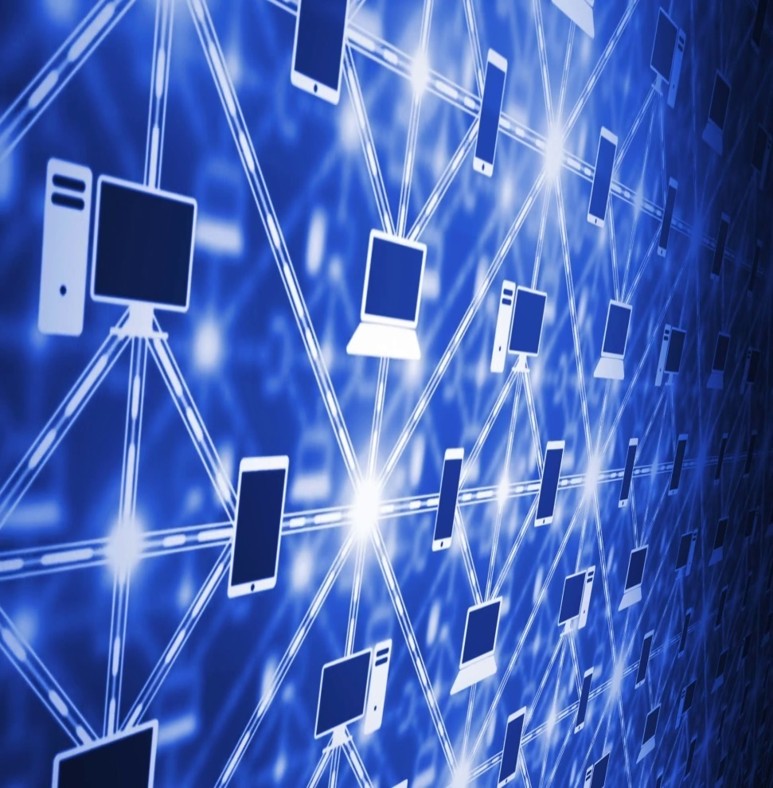
What is Network?
Computer Network is a collection of computers interconnect with each other and allows communication & collaboration between users.
OR
A network is a set of devices connected by communication links.

Slide 5
Applications of Networks
Resource Sharing
Hardware (computing resources, disks, printers)
Software (application software)
Access to remote database
Easy accessibility from anywhere (files, databases)
Search Capability (WWW)
Better Communication
Email
Message broadcast

Slide 6
Network Criteria
Network Criteria
A network must be able to meet a certain number of criteria. The most important of these are performance, reliability, and security.
Performance
Performance can be measured in many ways, including transit time and response time. Transit time is the amount of time required for a message to travel from one device to another. Response time is the elapsed time between an inquiry and a response.
Reliability
In addition to accuracy of delivery, network reliability is measured by the frequency of failure, the time it takes a link to recover from a failure, and the network’s robustness.
Security
Network security issues include protecting data from unauthorized access, protecting data from damage and development, and implementing policies and procedures for recovery from breaches and data losses.

Slide 7
Physical Structures
Type of connection:
Point-to-point:
A point-to-point connection provides a dedicated link between two devices
Multipoint:
A multipoint (also called multi-drop) connection is one in which more than two specific devices share a single link

Slide 8
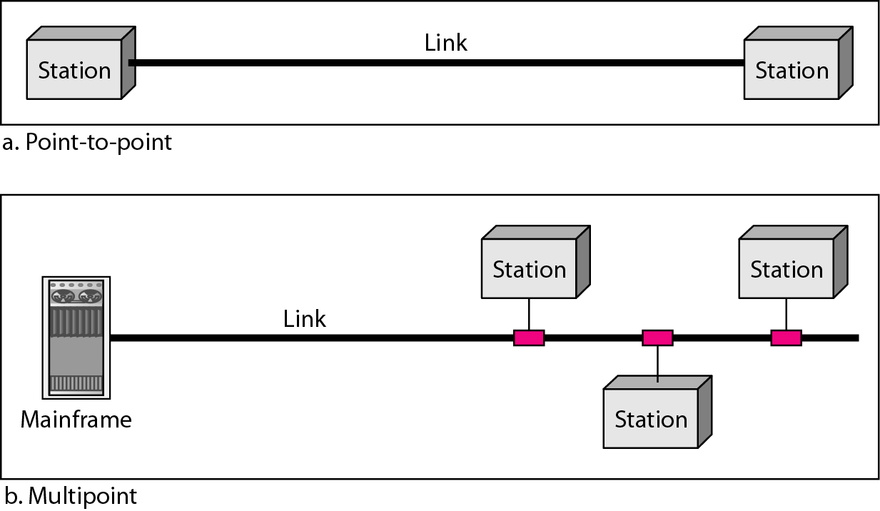

Slide 9
Topology
The topology of a network is the geometric representation of the relationship of all the links and linking devices (usually called nodes) to one another.
Physical Topology
The term physical topology refers to the way in which a network is laid out physically.
Types of topology:
Mesh Topology
Star Topology
Bus Topology
Ring Topology

Slide 10
Mesh Topology
In a mesh topology, every device has a dedicated point-to-point link to every other device.
To find the number of physical links in a fully connected mesh network with n nodes, we first consider that each node must be connected to every other node.
We need n (n – 1) physical links.
we need n (n – 1) / 2 duplex-mode links.

Slide 11
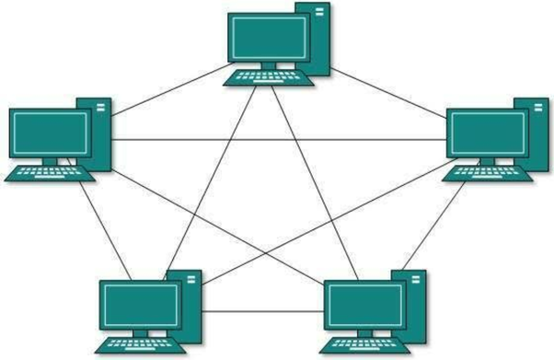
Mesh Topology

Slide 12
Advantages of Mesh Topology
First, the use of dedicated links guarantees that each connection can carry its own data load, thus eliminating the traffic problems that can occur when links must be shared by multiple devices.
Second, a mesh topology is robust
Third, there is the advantage of privacy or security
Finally, point-to-point links make fault identification and fault isolation easy.

Slide 13
Disadvantages of Mesh Topology
Cost
Management
Efficiency
Hardware requirement

Slide 14

Star Topology
In a star topology, each device has a dedicated point-to-point link only to a central controller, usually called a hub.
Unlike a mesh topology, a star topology does not allow direct traffic between devices. The controller acts as an exchange: If one device wants to send data to another, it sends the data to the controller, which then relays the data to the other connected device.

Slide 15
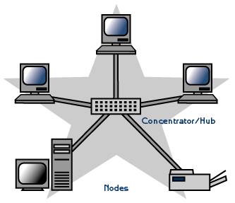
Star Topology

Slide 16
Advantages of Star Topology
A star topology is less expensive than a mesh topology
A star topology is robust
As long as the hub is working, it can be used to monitor link problems and defective links.

Slide 17
Disadvantages of Star Topology
One big disadvantage of a star topology is the dependency of the whole topology on one single point, the hub.
Although a star requires far less cable than a mesh, each node must be linked to a central hub. For this reason, often more cabling is required in a star than in some other topologies

Slide 18
Bus Topology
In Bus topology, every computer and network device is connected to a single cable.
It transmits the data in single direction.
A bus topology is multipoint. One long cable acts as a backbone to link all the devices in a network.
Nodes are connected to the bus cable by drop lines and taps.

Slide 19
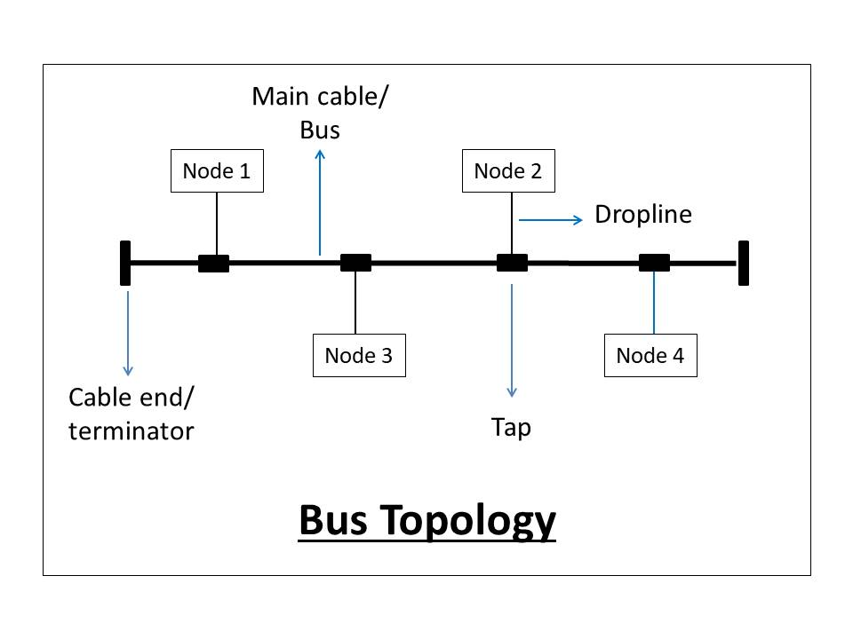

Slide 20
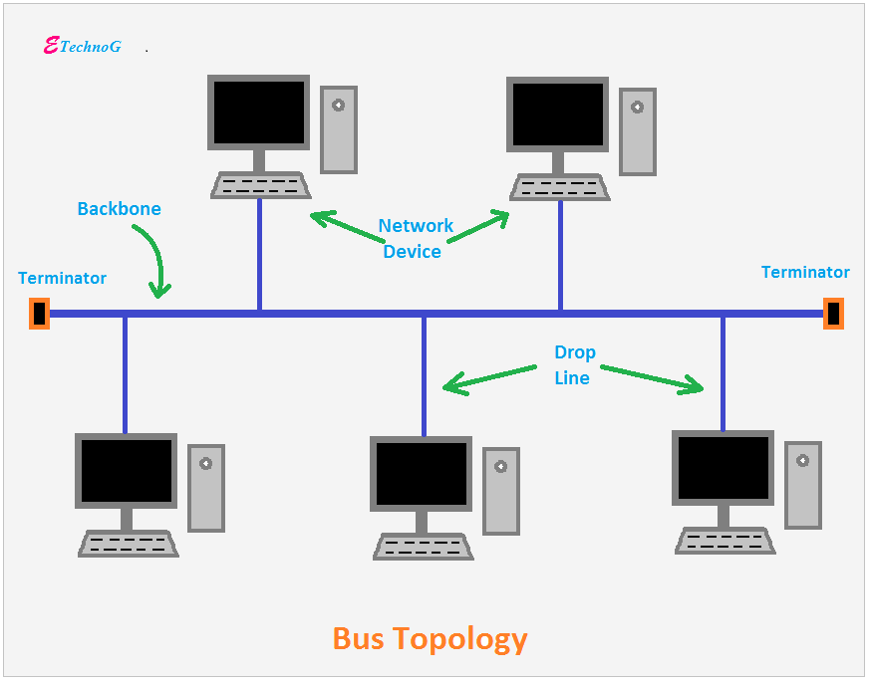

Slide 21
Advantages of Bus Topology
Advantages of a bus topology include ease of installation. Backbone cable can be laid along the most efficient path, then connected to the nodes by drop lines of various lengths.
A bus uses less cabling than mesh or star topologies.
In a bus, the redundancy is eliminated

Slide 22
Disadvantages of Bus Topology
A fault or break in the bus cable stops all transmission, even between devices on the same side of the problem
If the common cable fails, then the whole system will crash down.
If the two nodes send the messages simultaneously, then the signals of both the nodes collide with each other.
Adding new devices to the network would slow down the network
Security is very low .

Slide 23
Ring Topology
In a ring topology, each device has a dedicated point-to-point connection with only the two devices on either side of it.
Each device in the ring incorporates a repeater
When a device receives a signal intended for another device, its repeater regenerates the bits and passes them along

Slide 24
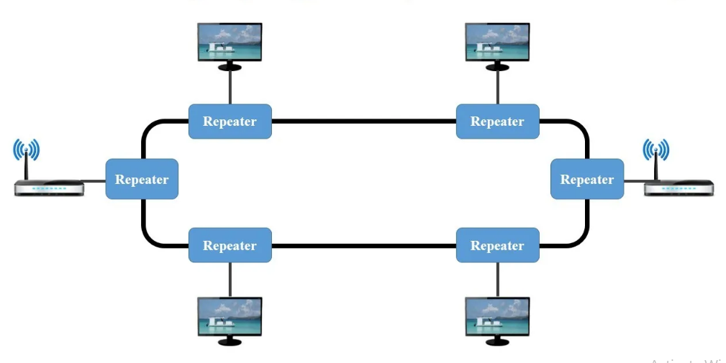
Ring Topology

Slide 25
Advantages of Ring Topology
In Ring topology, the possibility of data collision is minimal
Network controller server is not required
Data can be sent at a faster rate
This type of network is affordable
In a Ring topology network, any two new nodes can be added without difficulty.

Slide 26
Disadvantages of Ring Topology
It is much slower compared to a star topology
unidirectional traffic can be a disadvantage

Slide 27
Computer Network
Computer Network is a collection of computers interconnect with each other and allows communication & collaboration between users.
OR
A network is a set of devices connected by communication links.

Slide 28
Applications of Networks
Resource Sharing
Hardware (computing resources, disks, printers)
Software (application software)
Access to remote database
Easy accessibility from anywhere (files, databases)
Search Capability (WWW)
Better Communication
Email
Message broadcast

Slide 29
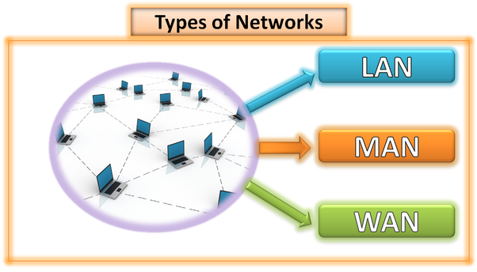
Types of Network

Slide 30
LAN(Local Area Network)
A Local Area Network is a computer network that interconnects computers within a limited area such as a residence, school, laboratory, university campus or office building.
LAN can setup in two ways:
Wired LAN (ex: Ethernet –Hub/switch)
Wireless LAN(ex: wi-fi)

Slide 31
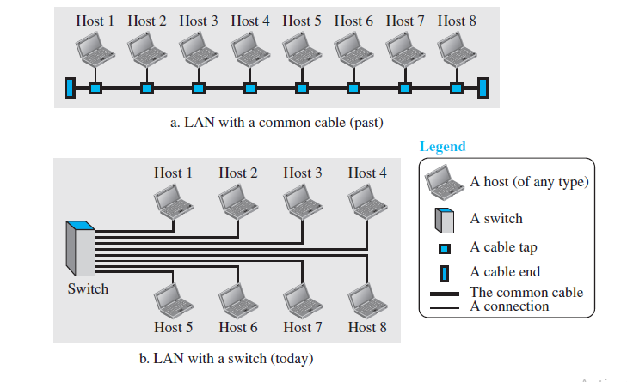
LAN(Local Area Network)

Slide 32
MAN(Metropolitan Area Network)
Metropolitan Area Network is a computer network that interconnects users with computer resources in a geographic region of the size of a metropolitan area(city).
The devices used in this MAN are:
Switches/Hub
Routers/Bridges
(Metropolitan Area Network

Slide 33
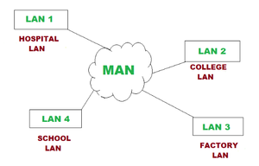
MAN(Metropolitan Area Network)

Slide 34
WAN(Wide Area Network)
A WAN, also called the Wide Area Network, is defined as a telecommunication network that extends over a large area.
The primary purpose of WAN is computer networking. The networks are linked to communicate with one another.

Slide 35
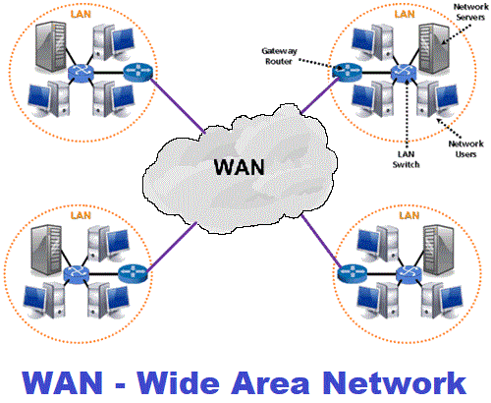
WAN(Wide Area Network)

Slide 36
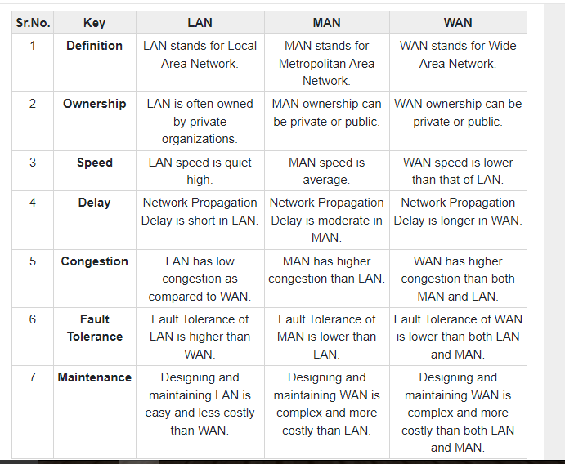
Differences b/w LAN, MAN and WAN

Slide 37
INTERNET HISTORY
Computers from different manufacturers were unable to communicate with one another.
The Advanced Research Projects Agency (ARPA) in the Department of Defense (DOD) was interested in finding a way to connect computers so that the researchers they funded could share their findings, thereby reducing costs and eliminating duplication of effort.
The idea was that each host computer (not necessarily from the same manufacturer) would be attached to a specialized computer, called an interface message processor (IMP).

Slide 38
INTERNET HISTORY
In 1972, Vint Cerf and Bob Kahn, both of whom were part of the core ARPANET group, collaborated on what they called the Internetting Project.
They wanted to link dissimilar networks so that a host on one network could communicate with a host on another

Slide 39
INTERNET HISTORY
A new communications protocol was established called Transfer Control Protocol/Internetwork Protocol (TCP/IP).
This allowed different kinds of computers on different networks to "talk" to each other.

Slide 40
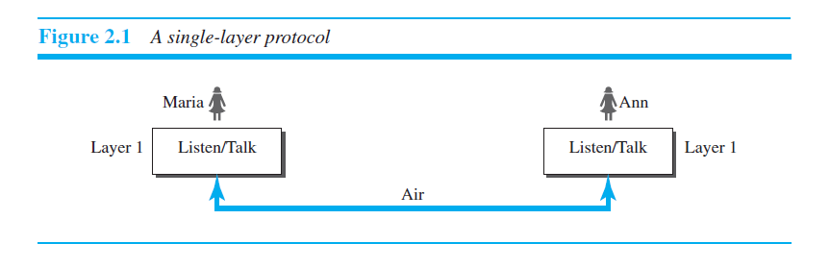

PROTOCOL LAYERING

Slide 41
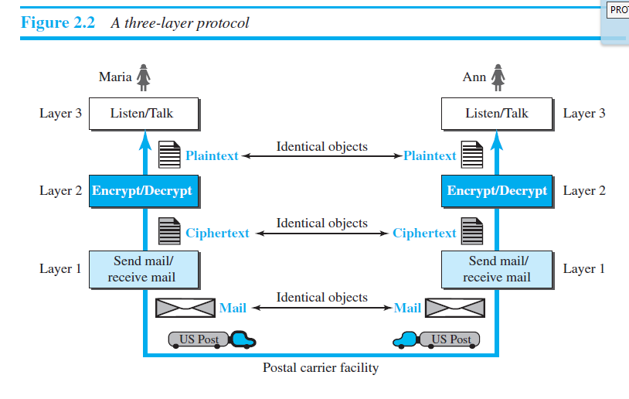
PROTOCOL LAYERING

Slide 42
Principles of Protocol Layering
First Principle
The first principle dictates that if we want bidirectional communication, we need to make each layer so that it is able to perform two opposite tasks, one in each direction.
For example, the third layer task is to listen (in one direction) and talk (in the other direction). The second layer needs to be able to encrypt and decrypt. The first layer needs to send and receive mail.

Slide 43
Second Principle
The second principle that we need to follow in protocol layering is that the two objects under each layer at both sites should be identical.
For example, the object under layer 3 at both sites should be a plaintext letter. The object under layer 2 at both sites should be a ciphertext letter. The object under layer 1 at both sites should be a piece of mail.

Slide 44
OSI MODEL
Open Systems Interconnection (OSI) model is a standard proposed by International Organization for Standardization (ISO)
An open system is a set of protocols that allows any two different systems to communicate regardless of their underlying architecture
The OSI model is a layered framework for the design of network systems that allows communication between all types of computer systems

Slide 45
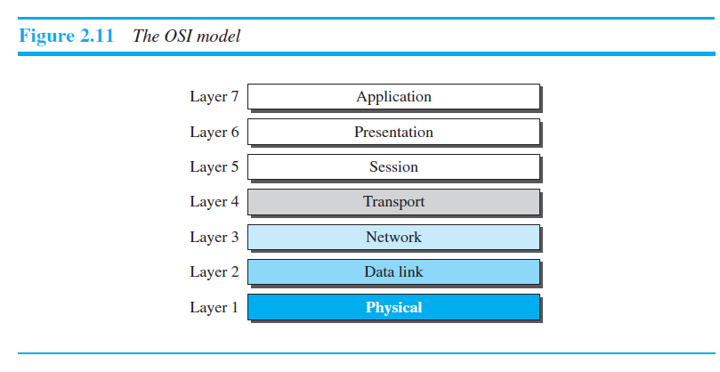
OSI MODEL

Slide 46
User Support Layer( Application, Presentation, Session Layer)
Transport Layer
Network Support Layer (Network, Datalink, Physical Layer)

Slide 47
Physical Layer
Physical Layer is responsible for transmitting a bit stream over a physical channel.
It also deals with mechanical properties and electrical properties of the interface and transmission medium.
Physical Layer is responsible for:
transmission rate
Physical topology
Bit synchronization

Slide 48
Data-link Layer
This layer is responsible for sending groups of packets to the adjacent nodes without any errors.
This is called node-to-node delivery
Data-link Layer is responsible for:
Framing
Physical Addressing
Error Control
Media Access Control

Slide 49
Network Layer
The network layer is responsible for routing the packets from one network to another network.
This is referred to as source to the destination delivery.
Path determination : open shortest path first

Slide 50
Transport Layer
Responsible for end to end delivery of the entire message.
Segmentation and reassembly
Flow control
Error control
Protocols: TCP (Connection oriented service), UDP (Connection less service)

Slide 51
Session Layer
The main function of Session Layer is to establish, authorization, authentiacation and synchronize the interactions between two connected devices.
SERVER
PC

Slide 52
Presentation Layer
This layer is responsible for presenting the data in reliable format or in a suitable format.
Responsibilities:
Translation
Encryption and Decryption:ssl
Compression
Lossy
Lossless

Slide 53
Application Layer
It enables the user to access the network
It provides interfaces and support for services such as e-mail, ftp, distributed information services etc.
Responsibilities:
File transfer, Access and Management
Mail services
Online shopping

Slide 54
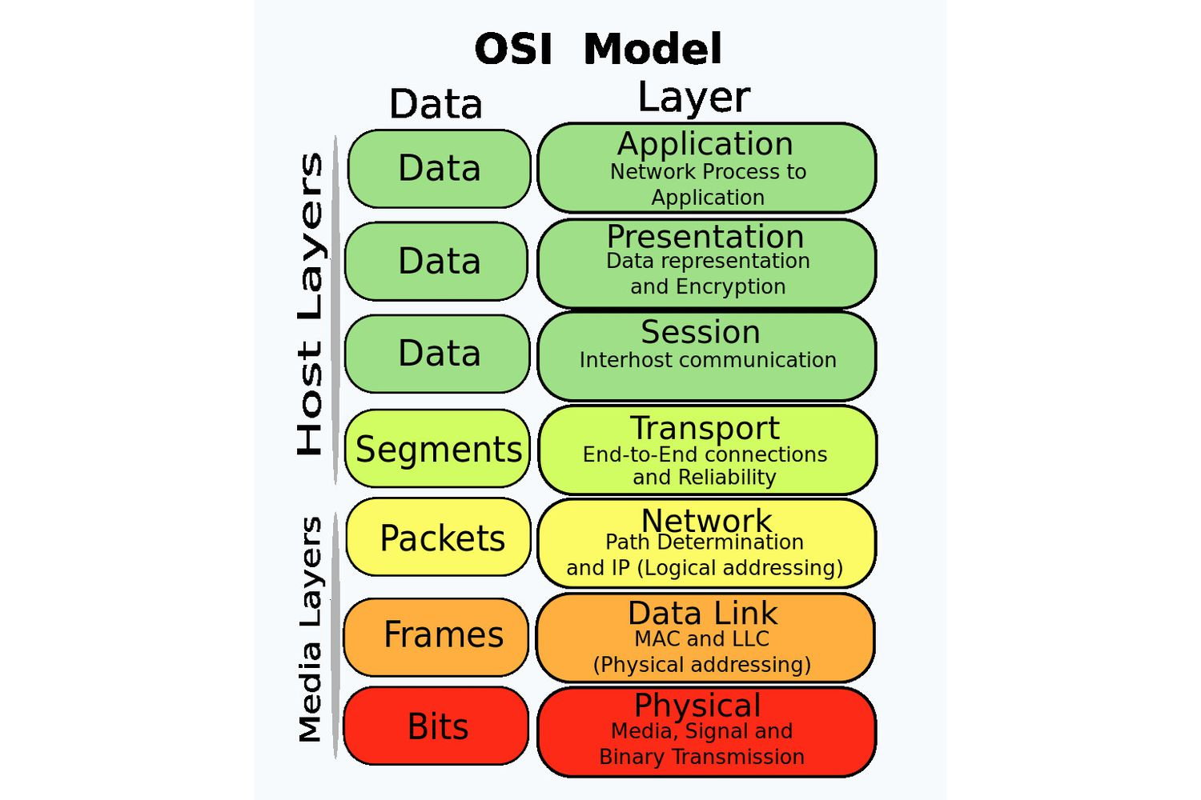
OSI MODEL

Slide 55
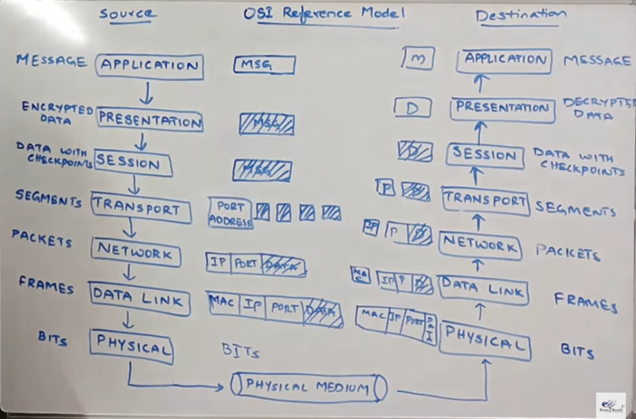
OSI MODEL

Slide 56
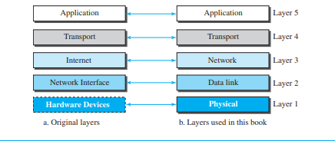
TCP/IP PROTOCOL SUITE

Slide 57
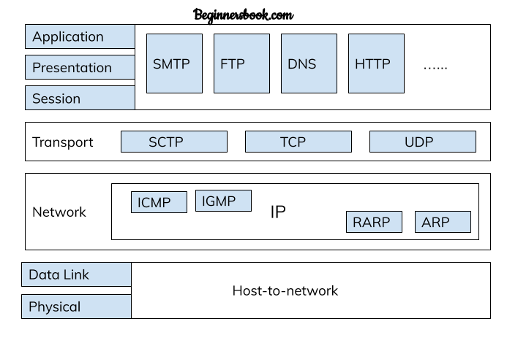

TCP/IP PROTOCOL SUITE

Slide 58
1. Physical and Data Link Layer
Physical and Data Link Layers in TCP/IP model does not define any protocols, they support all the standard protocols. They are combined known as host-to-network layer. A network in TCP/IP internetwork can be LAN or WAN.

Slide 59
2. Network Layer
In the network layer, the TCP/IP model supports internetworking protocol in short known as IP. The IP uses four protocols internally: ARP, RARP, ICMP & IGMP.
Address Resolution Protocol (ARP)
Reverse Address Resolution Protocol (RARP)
Internet Control Message Protocol (ICMP)
Internet Group Message Protocol (IGMP)

Slide 60
3. Transport Layer
Transport layer in TCP/Model can be represented by three protocols: Transmission control protocol (TCP), User data gram protocol (UDP) and Stream Control Transmission Protocol (SCTP).
User Datagram protocol (UDP)
Transmission control protocol (TCP)
Stream Control Transmission Protocol (SCTP)

Slide 61
4. Application Layer
HTTP: HTTP stands for Hypertext transfer protocol
FTP: FTP stands for File Transfer Protocol
DNS: DNS stands for Domain Name System.
SMTP: SMTP stands for Simple mail transfer protocol.

Slide 62
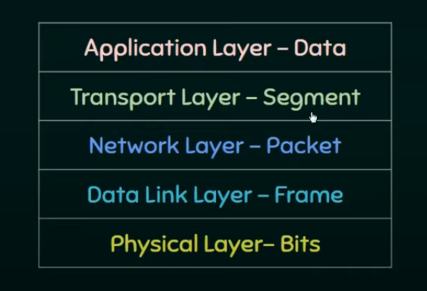

Slide 63
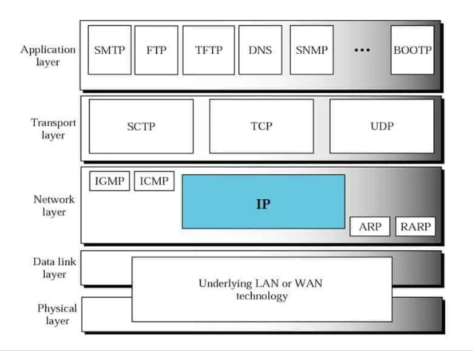

Slide 64
TCP/IP PROTOCOL SUITE
Application Layer
Hypertext Transfer Protocol (HTTP)
Simple Mail Transfer Protocol (SMTP)
File Transfer Protocol (FTP)
Transport Layer
Transmission Control Protocol (TCP)
User Datagram Protocol (UDP)

Slide 65
TCP/IP PROTOCOL SUITE
Network Layer
Internet Protocol
Routers
Data-link Layer
Ethernet and switches
Physical Layer
Cables and NIC(Network Interface Card)

Slide 66
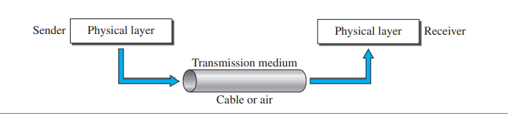
Transmission media
Transmission media is the way the systems are connected to route data signals in a network.
Physical path

Slide 67
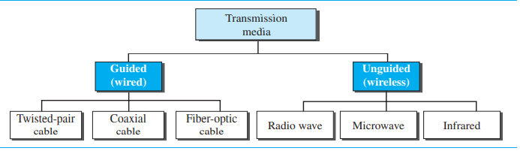
Transmission medium can be defined as anything that can carry information from a source to a destination.
The transmission medium is usually free space, metallic cable or fiber-optic cable.

Slide 68
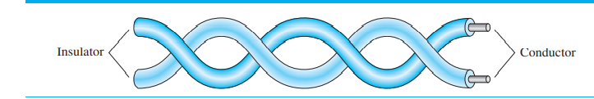
Guided media
Guided transmission media consists of physical connection between source and destination through a wire or a cable.
It includes twisted-pair cable, coaxial cable, and fiber-optic cable.
Twisted-Pair Cable: Cable consists of two conductors (normally copper) each with its own plastic insulation, twisted together.

Slide 69
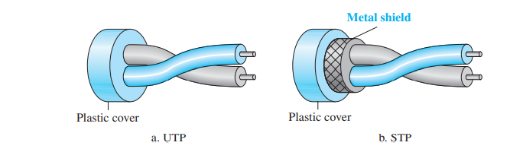
Unshielded Versus Shielded Twisted-Pair Cable
unshielded

Slide 70
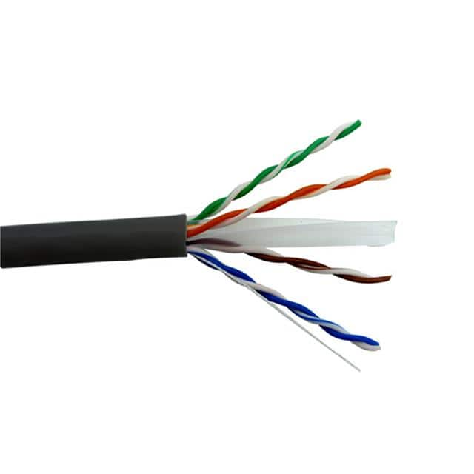
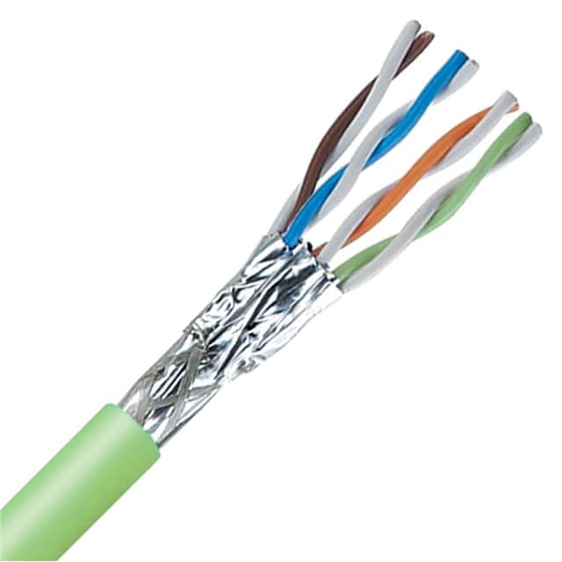
Unshielded Versus Shielded Twisted-Pair Cable

Slide 71
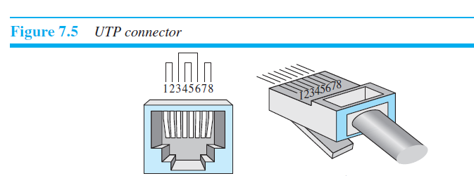
Connectors: UTP 3, UTP 5, UTP 7

Slide 72
Applications
Twisted-pair cables are used in telephone lines
The local loop—the line that connects subscribers to the central telephone office.
The DSL (Digital Subscriber Lines) lines used by telephone companies use unshielded twisted pair cable.
Twisted pair copper wires are also used in Ethernet LAN cables within homes and offices.

Slide 73
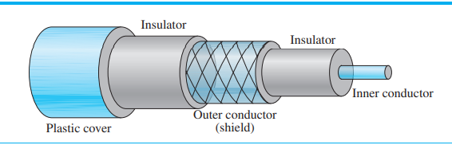
Coaxial Cable
Co-axial copper cables consist of inner copper conductor and an outer copper shield, which are separated by a di-electric insulating material, helpful in preventing signal losses.

Slide 74
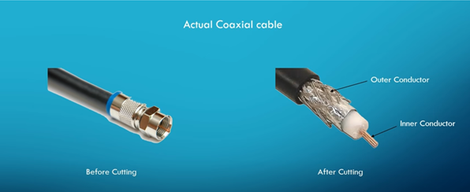
Coaxial Cable

Slide 75
Applications
Analog Telephone Networks-10000 voices
Digital Telephone Networks- 600Mbps
Cable TV networks
Ethernet LANs

Slide 76
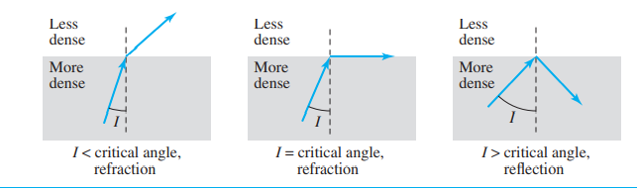
Fiber-Optic Cable
A fiber-optic cable is made of glass or plastic and transmits signals in the form of light.
In fiber optic cable the information is transmitted by propagation of optical signals (light) through fiber optic cables and not through the electrical/electromagnetic signals. Because of this, the fiber optics communication supports longer distances as there is no electrical interference. Internet lines.

Slide 77
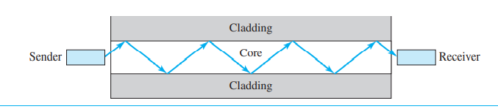
Optical fibers use reflection to guide light through a channel.
A glass or plastic core is surrounded by a cladding of less dense glass or plastic.
The difference in density of the two materials must be such that a beam of light moving through the core is reflected off the cladding instead of being refracted into it.

Slide 78
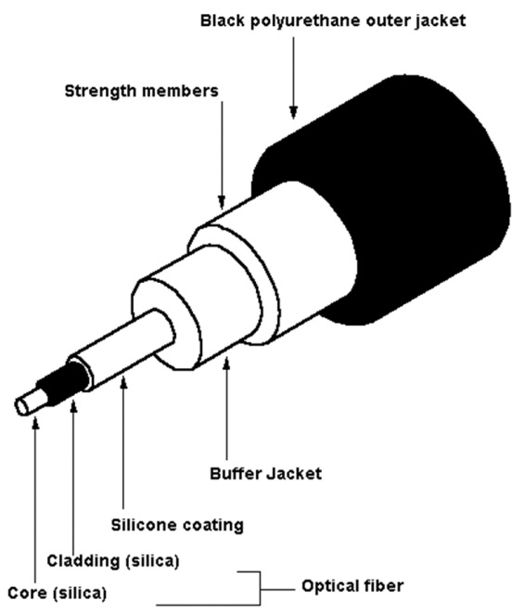
Optical fiber

Slide 79
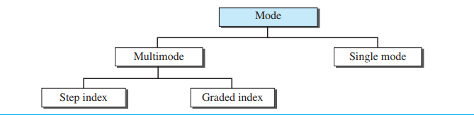
In Multimode multiple beams from a light source move through the core in different paths.
Fiber optics propagation modes:

Slide 80
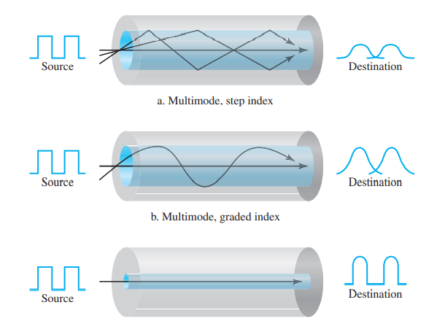
Multimode

Slide 81
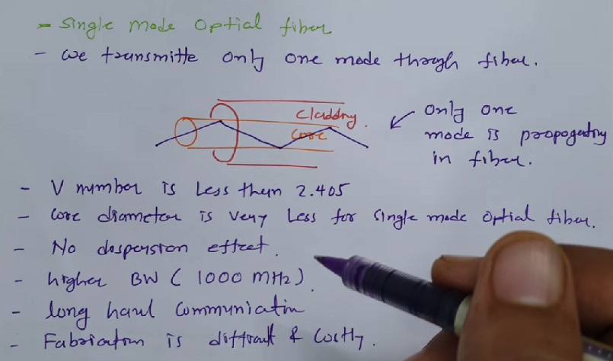

Slide 82
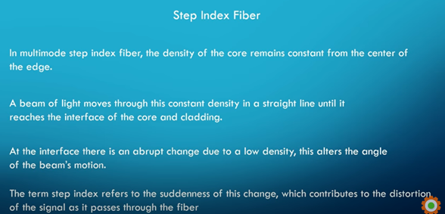

Slide 83
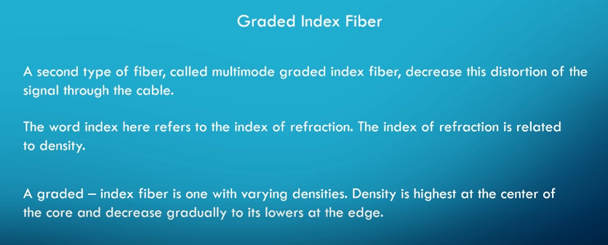

Slide 84
Advantages
Higher bandwidth
Less signal attenuation
Immunity to electromagnetic interference
Resistance to corrosive materials
Light weight

Slide 85
Disadvantages
Installation and maintenance
Unidirectional light propagation
Cost

Slide 86
UnGuided Transmission
An unguided transmission transmits the electromagnetic waves without using any physical medium. Therefore it is also known as wireless transmission.
In unguided media, air is the media through which the electromagnetic energy can flow easily.
Signals are normally broadcast through free space and thus are available to anyone who has a device capable of receiving them.

Slide 87
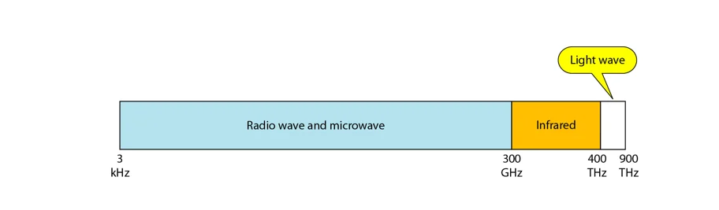
UnGuided Transmission
The below figure shows the part of the electromagnetic spectrum, ranging from 3 kHz to 900 THz, used for wireless communication.

Slide 88
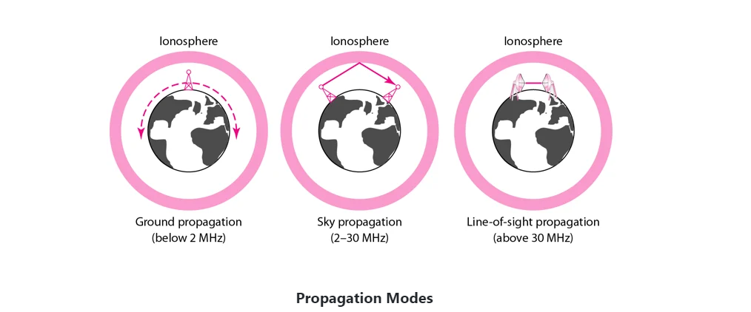
Unguided signals can travel from the source to destination in several ways:

Slide 89
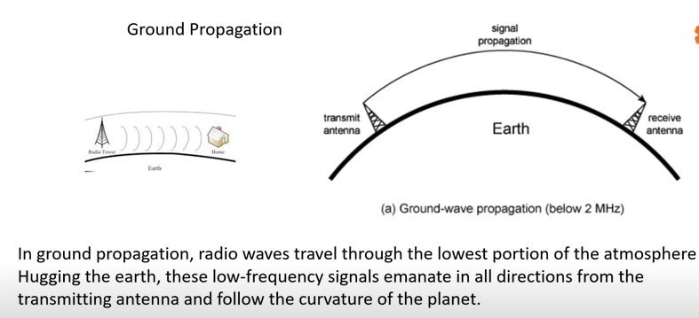

Slide 90
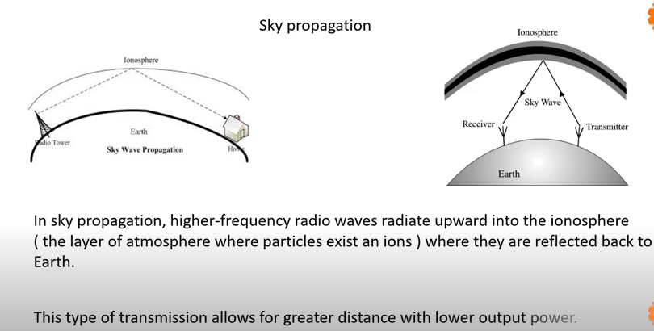

Slide 91
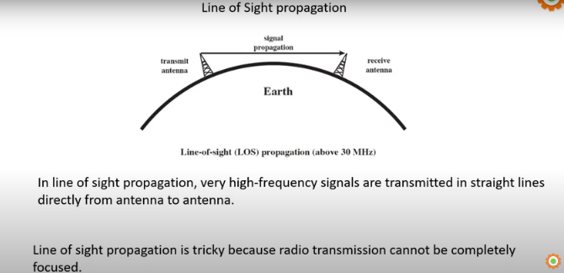

Slide 92
Radio Waves
Radio waves are the electromagnetic waves that are transmitted in all the directions of free space.
Radio waves are omnidirectional, i.e., the signals are propagated in all the directions.
The range in frequencies of radio waves is from 3Khz to 1 Ghz.
In the case of radio waves, the sending and receiving antenna are not aligned.
An example of the radio wave is FM radio.

Slide 93
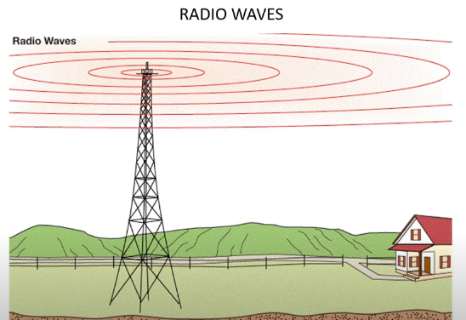

Slide 94
Applications of Radio waves
A Radio wave is useful for multicasting when there is one sender and many receivers.
An FM radio, television, cordless phones are examples of a radio wave.

Slide 95
Advantages and Disadvantages of Radio Transmission
Advantages :
Radio waves are mainly used for Wide Area Networks (WAN) for example: Mobile networks.
Suitable for longer distance communications.
Signals can penetrate walls.
Higher data transmission rate compared to other transmission mediums.
Disadvantages :
Waves are omnidirectional so faces interference from other signals of same frequency so disturbance can be there.
Not possible to isolate the communication inside the building.

Slide 96
Microwaves
Microwaves are of two types:
Terrestrial microwave
Satellite microwave communication.

Slide 97
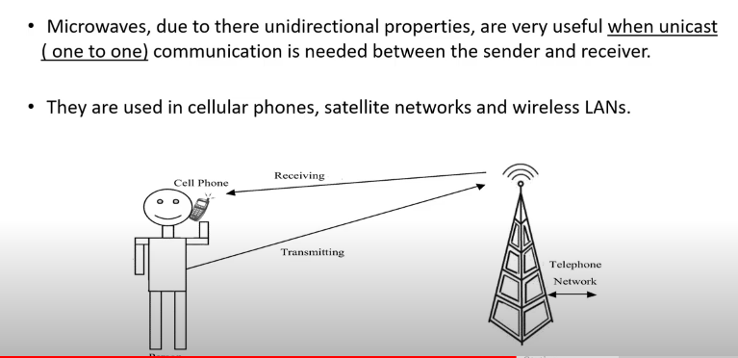
Microwaves

Slide 98
Terrestrial Type Microwave Transmission
Frequency range : 4-6Ghz
Bandwidth :1-10Mbps
Cost
Attenuation
Implementation

Slide 99
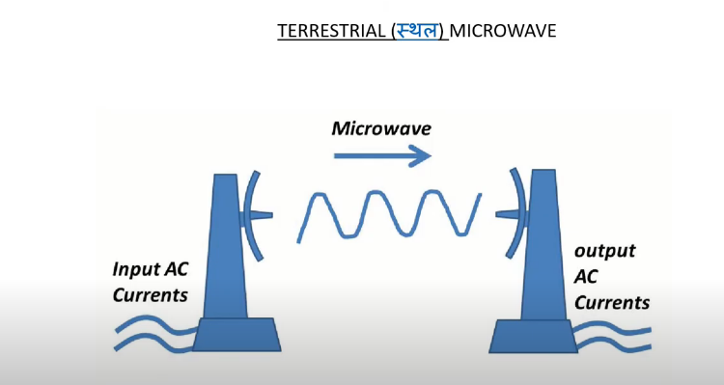
Terrestrial Type Microwave Transmission

Slide 100
Advantages of Terrestrial type microwave transmission:
It is cheaper than cable transmission
Possible to implement in areas where cable transmission is difficult to implement such as hill areas.
Disadvantages of Terrestrial type microwave transmission:
Not secure, susceptible to eavesdropping.
Weather condition can affect the transmission.
Limited bandwidth.

Slide 101
Satellite type microwave transmission
Advantages of Satellite type transmission:
The transmission can be done to the longer distances.
Unlike terrestrial transmission where the implementation cost goes higher based on the transmission distance, the satellite communication is unaffected by the distance of the data transmission.

Slide 102
Disadvantages of Satellite type transmission:
Satellite designing and development requires more time and higher cost.
The life of the satellite is about 12-15 years. Due to this reason, another launch of the satellite has to be planned before it becomes non-functional.
Installation of satellite is extremely tough.

Slide 103
Infrared Transmission
Infrared waves are highest frequency waves, frequency ranges from 300GHz to 400 THz.
Suitable for short distance communication.
Bandwidth is high so data transmit rate is high compared to other mediums.
These waves cannot penetrate walls, thus they are ideal for isolated communications.

Slide 104
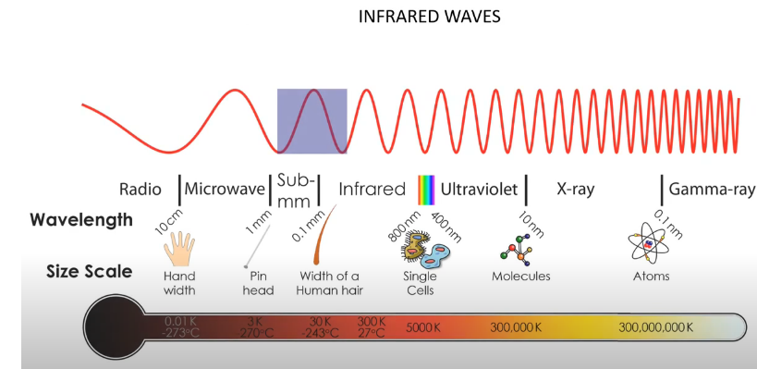
Infrared Transmission

Slide 105
Advantages of Infrared Transmission:
Secure
High speed
High frequency signals
High data transfer rate

Slide 106
Disadvantages of Infrared Transmission:
Sun rays interfere with the infrared rays so not ideal for outdoor communication.
Suitable for short distance communication only.
Cannot penetrate walls so difficult to establish a communication between two different rooms.

Slide 107
Switching
Switching in computer networks helps in deciding the best route for data transmission if there are multiple paths in a large network

Slide 108
Switching
A switched network consists of a series of interlinked nodes, called switches.
Switches are devices capable of creating temporary connections between two or more devices linked to the switch.
In a switched network, some of these nodes are connected to the end systems (computers or telephones, for example). Others are used only for routing.

Slide 109
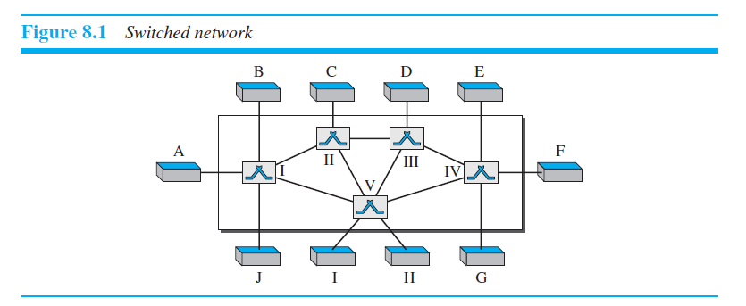
Switching

Slide 110
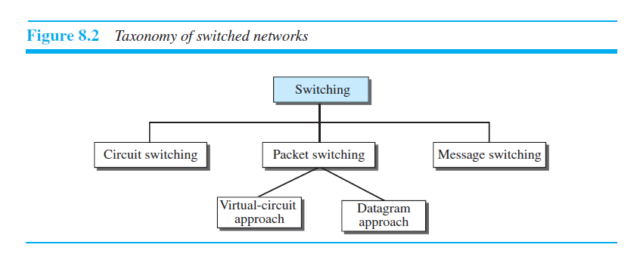
Three Methods of Switching

Slide 111
CIRCUIT-SWITCHED NETWORKS
A dedicated path is established between the sender and receiver.
A circuit-switched network is made of a set of switches connected by physical links, in which each link is divided into n channels. Eg Telephone Network.
Three Phases:
Setup Phase
Data-Transfer Phase
Teardown Phase

Slide 112
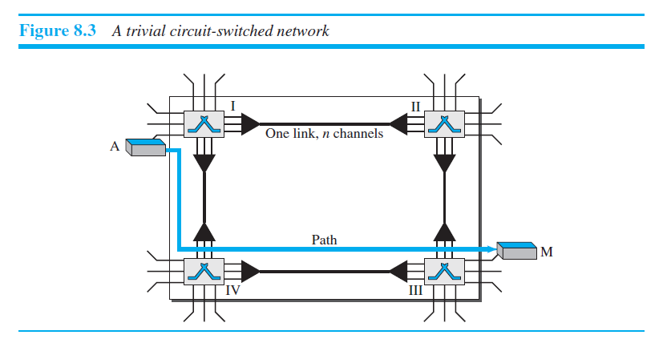
CIRCUIT-SWITCHED NETWORKS

Slide 113

CIRCUIT-SWITCHED NETWORKS

Slide 114
Message-Switched Networks
Store and forward mechanism
Message is transferred as a complete unit and forwarded using store and forward mechanism at the intermediary node.
Not suited for streaming media and real time applications.

Slide 115
Message-Switched Networks
In Message-Switching there is no dedicated path between the sender and receiver like circuit switching.
The sender and receiver are connected by way of several intermediate nodes which helps and ensures proper data transfer between them.
Message-Switched data networks are also known as hop-by-hop systems.

Slide 116

Message-Switched Networks

Slide 117

PACKET SWITCHING

Slide 118

PACKET SWITCHING

Slide 119


Slide 120

Packet Switching - Datagram

Slide 121


Slide 122


Slide 123
Module -II: DATA LINK LAYER
Introduction: Link layer addressing; Error detection and correction: Cyclic codes, checksum, forward error correction; Data link control: DLC services, data link layer protocols, media access control: Random access, virtual LAN.

Slide 124

Module -II: DATA LINK LAYER

Slide 125
Link layer addressing
A link-layer address is called a link address, called a physical address, and sometimes a MAC address or hardware address. Since a link is controlled at the data-link layer, the addresses need to belong to the data-link layer.
48-bits address for Ethernet
Example: A1:D4:FF:45:78:12 (Hexadecimal)

Slide 126

Link layer addressing

Slide 127
Three Types of addresses
Unicast Address : one-to-one
Multicast Address : one-to-many
Broadcast Address : one-to-all
Examples:
A3:34:45:11:92:F1
A2:34:45:11:92:F1
FF:FF:FF:FF:FF:FF

Slide 128

Address Resolution Protocol (ARP)

Slide 129

ARP OPERATION

Slide 130

ARP PACKET FORMAT

Slide 131
Error Detection and Correction
An error is something you have done which is considered to be incorrect or wrong, or which should not have been done.
Types of Errors:
Single-bit error – 1 bit change
Multiple-bit error – non-consecutive bits
Burst error - consecutive bits

Slide 132


Slide 133
Error Control
Error control can be done in two ways
Error detection
Error correction

Slide 134
Error Detection Techniques
Single parity check
Two-dimensional parity check
Checksum
Cyclic redundancy check

Slide 135
Parity Check
If a number of 1s is even then parity bit value is 0. If the number of 1s is odd then parity bit value is 1.

Slide 136

Single Parity Check

Slide 137
Drawbacks Of Single Parity Checking
It can only detect single-bit errors which are very rare.
If two bits are interchanged, then it cannot detect the errors.

Slide 138

Two-dimensional parity check

Slide 139
Drawbacks Of 2D Parity Check
If two bits in one data unit are corrupted and two bits exactly the same position in another data unit are also corrupted, then 2D Parity checker will not be able to detect the error.
This technique cannot be used to detect the 4-bit errors or more in some cases.

Slide 140
Checksum
For error detection by checksums, data is divided into fixed size frames or segments.
Sender’s End − The sender adds the segments using 1’s complement arithmetic to get the sum. It then complements the sum to get the checksum and sends it along with the data frames.
Receiver’s End − The receiver adds the incoming segments along with the checksum using 1’s complement arithmetic to get the sum and then complements it.
If the result is zero, the received frames are accepted; otherwise they are discarded.

Slide 141


Slide 142

10011001 11100010 00100100 10000100

Slide 143
Cyclic Redundancy check
It is an error detection method based on binary division.
In CRC, a seq of redundant bits called cyclic redundancy. check bits are appended to the end of data, so that the resulting data unit becomes exactly divisible by second, predetermined binary no.
At the destination, the incoming data is divided by same no.
If the remainder is ‘0’ – data is accepted otherwise not accepted.

Slide 144

Cyclic Redundancy Check (CRC)

Slide 145
Cyclic Redundancy Check (CRC)
CRC Generator
Frame- 1010101010
Key-11001
CRC Checker
Frame- 1010101010
Key-11001
Reminder =0000

Slide 146
Error Correction Techniques
Backward Error Correction (Retransmission) − If the receiver detects an error in the incoming frame, it requests the sender to retransmit the frame. It is a relatively simple technique. But it can be efficiently used only where retransmitting is not expensive as in fiber optics and the time for retransmission is low relative to the requirements of the application.

Slide 147
Forward Error Correction − If the receiver detects some error in the incoming frame, it executes error-correcting code that generates the actual frame. This saves bandwidth required for retransmission. It is inevitable in real-time systems. However, if there are too many errors, the frames need to be retransmitted.

Slide 148
Data Link Control(DLC)
DLC SERVICES:
Framing
Flow and Error Control
Connectionless and Connection-Oriented

Slide 149

Framing
Framing is a function of DLL which provides way for sender to transmit a set of bits that are meaningful to the receiver.

Slide 150
Framing
Frame Size:
Fixed-size framing
Variable-size framing
Variable-size framing:
Character-Oriented Framing
Byte-Oriented Framing
Bit-Oriented Framing

Slide 151

Character-Oriented Framing

Slide 152

Character-Oriented Framing
8

Slide 153


Slide 154

Bit-Oriented Framing

Slide 155


Slide 156


Slide 157

Flow Control

Slide 158

Flow Control

Slide 159
Connectionless and Connection-Oriented
Connectionless Protocol:
In a connectionless protocol, frames are sent from one node to the next without any relationship between the frames
Each frame is independent
Connection-Oriented Protocol
In a connection-oriented protocol, a logical connection should first be established between the two nodes (setup phase).
After all frames that are somehow related to each other are transmitted (transfer phase),
the logical connection is terminated (teardown phase).

Slide 160
DATA-LINK LAYER PROTOCOLS
Data link layer protocols
Noiseless Medium
Simplest
Stop and Wait
Noisy Medium
Go Back-N
Selective Repeat

Slide 161

DATA-LINK LAYER PROTOCOLS
FSM (Finite State Machine) tells the behaviour of protocols. It contains finite no. of states.
It will do 2 different actions: i. Defining the list of actions to be performed,
ii. Determining the next state.

Slide 162

Simple Protocol
No flow control or error control

Slide 163


Slide 164

Decapsulation
encapsulation

Slide 165

Stop-and-Wait Protocol

Slide 166


Slide 167

Frame sequence no when duplicate issue occurs: 0,1,0, 1
Ack: 1,0,1,0

Slide 168
Frame sequence no when duplicate issue occurs: 0,1,0, 1
Ack: 1,0,1,0

Slide 169
Sliding Window Protocol
Sliding window protocol has two types:
Go-Back-N ARQ
Selective Repeat ARQ

Slide 170

Sliding Window Protocol

Slide 171

Sliding Window Protocol

Slide 172

Sliding Window Protocol

Slide 173

Sliding Window Protocol

Slide 174

Sliding Window Protocol

Slide 175

HDLC

Slide 176

Configurations and Transfer Modes

Slide 177
Framing
information frames(I-frames) : control information relating to user data
supervisory frames (S-frames) : to transport control information
unnumbered frames (U-frames): are reserved
for system management.

Slide 178

Framing

Slide 179
Fields and their use in different frame types
Flag field
Address field
Control field
Information field
FCS field

Slide 180


Slide 181

POINT-TO-POINT PROTOCOL (PPP)

Slide 182
Framing
Flag
Address
Control
Protocol
Payload field
FCS

Slide 183

Transition Phases

Slide 184
Media Access Protocol
The data link layer is the second lowest layer. It is divided into two sublayers −
The logical link control (LLC) sublayer
The medium access control (MAC) sublayer
Medium access control protocols are mechanisms that allow several users or transmitters to access a common medium or channel.
Medium Access Control it will coordinate access to broadcast links.

Slide 185

Media Access Protocol

Slide 186
ALOHA Random Access Protocol
Random Access is a method to transmission of data is done randomly.
The ALOHA protocol was first developed at the University of Hawaii in the early 1970s for packet radio networks.
Aloha Rules:
Any station can transmit data to a channel at any time.
It does not require any carrier sensing.
Acknowledgment of the frames exists in Aloha.
It requires retransmission of data after some random amount of time.

Slide 187
Pure ALOHA Random Access Protocol
Pure ALOHA refers to the original ALOHA protocol. The idea is that each station sends a frame whenever one is available. Because there is only one channel to share, there is a chance that frames from different stations will collide.
When two frames attempt to occupy the channel simultaneously, a collision occurs and both frames become garbled. If the first bit of a new frame overlaps with the last bit of a frame that is almost finished, both frames will be completely destroyed and will need to be retransmitted. If all users retransmit their frames at the same time after a time-out, the frames will collide again.
To prevent this, the pure ALOHA protocol dictates that each user waits a random amount of time, known as the back-off time, before retransmitting the frame. This randomness helps to avoid further collisions.

Slide 188

Pure Aloha

Slide 189

Pure Aloha
Back-off time: Each sender wait for a random amount of time before resending a frame.
to

Slide 190
ALOHA Random Access Protocol
Vulnerable period
The Length of time in which there is possibility of collision is called vulnerable time.
Similarly, if another user wants to transmit between (to, +tp) and (to +2tp) i.e. packet C, the beginning of packet C will collide with the end of packet A. Thus if two packets overlap by even the smallest amount in the vulnerable period both packets will be corrupted and need to be retransmitted.

Slide 191

ALOHA Random Access Protocol
The time-out period is equal to the maximum possible round-trip propagation delay, which is twice the amount of time required to send a frame between the two most widely separated stations (2 x Tp).

Slide 192
Slotted ALOHA
Slotted ALOHA channel is divided into small, fixed-length time slots and users are only allowed to transmit data at the beginning of each time slot. This synchronization of transmissions reduces the chances of collisions between devices, increasing the overall efficiency of the network.

Slide 193

Slotted Aloha

Slide 194
CSMA (Carrier Sense Multiple Access)
This method was developed to decrease the chances of collisions when two or more stations start sending their signals over the data link layer. Carrier Sense multiple access requires that each station first check the state of the medium before sending.

Slide 195

CSMA (Carrier Sense Multiple Access)

Slide 196
CSMA (Carrier Sense Multiple Access)
CSMA Access Modes:
1-Persistent
Non-Persistent
P-Persistent

Slide 197

CSMA (Carrier Sense Multiple Access)

Slide 198

1-Persistant

Slide 199

CSMA (Carrier Sense Multiple Access)

Slide 200

Non-Persistent

Slide 201

CSMA (Carrier Sense Multiple Access)

Slide 202

P-Persistent

Slide 203


Slide 204
CSMA/ CD
It is a carrier sense multiple access/ collision detection network protocol to transmit data frames. The CSMA/CD protocol works with a medium access control layer.
Therefore, it first senses the shared channel before broadcasting the frames, and if the channel is idle, it transmits a frame to check whether the transmission was successful.
If the frame is successfully received, the station sends another frame. If any collision is detected in the CSMA/CD, the station sends a jam/ stop signal to the shared channel to terminate data transmission. After that, it waits for a random time before sending a frame to a channel.

Slide 205

CSMA/CD

Slide 206

CSMA/CD

Slide 207
CSMA/ CA
It is a carrier sense multiple access/collision avoidance network protocol for carrier transmission of data frames. It is a protocol that works with a medium access control layer.
When a data frame is sent to a channel, it receives an acknowledgment to check whether the channel is clear. If the station receives only a single (own) acknowledgments, that means the data frame has been successfully transmitted to the receiver.
But if it gets two signals (its own and one more in which the collision of frames), a collision of the frame occurs in the shared channel. Detects the collision of the frame when a sender receives an acknowledgment signal.

Slide 208

CSMA/ CA

Slide 209
Following are the methods used in the CSMA/ CA to avoid the collision:
Inter frame space: In this method, the station waits for the channel to become idle, and if it gets the channel is idle, it does not immediately send the data. Instead of this, it waits for some time, and this time period is called the Inter frame space or IFS. However, the IFS time is often used to define the priority of the station.
Contention window: In the Contention window, the total time is divided into different slots. When the station/ sender is ready to transmit the data frame, it chooses a random slot number of slots as wait time. If the channel is still busy, it does not restart the entire process, except that it restarts the timer only to send data packets when the channel is inactive.
Acknowledgment: In the acknowledgment method, the sender station sends the data frame to the shared channel if the acknowledgment is not received ahead of time.

Slide 210
Virtual LAN
Virtual Local Area Networks or Virtual LANs (VLANs) are a logical group of computers that appear to be on the same LAN irrespective of the configuration of the underlying physical network. Network administrators partition the networks to match the functional requirements of the VLANs so that each VLAN comprise of a subset of ports on a single or multiple switches or bridges. This allows computers and devices in a VLAN to communicate in the simulated environment as if it is a separate LAN.

Slide 211

Virtual LAN

Slide 212

Virtual LAN

Slide 213
Virtual LAN
VLANs benefits:
Improved network security: VLANs can be used to separate network traffic and limit access to specific network resources. This improves security by preventing unauthorized access to sensitive data and network resources.
Better network performance: By segregating network traffic into smaller logical networks, VLANs can reduce the amount of broadcast traffic and improve network performance.
Simplified network management: VLANs allow network administrators to group devices together logically, rather than physically, which can simplify network management tasks such as configuration, troubleshooting, and maintenance.
Flexibility: VLANs can be configured dynamically, allowing network administrators to quickly and easily adjust network configurations as needed.
Cost savings: VLANs can help reduce hardware costs by allowing multiple virtual networks to share a single physical network infrastructure.
Scalability: VLANs can be used to segment a network into smaller, more manageable groups as the network grows in size and complexity.

Slide 214

Virtual LAN

Slide 215

Virtual LAN

Slide 216
Network Layer
MODULE-3

Slide 217
The main functions performed by the network layer are:
Routing
Logical Addressing
Internetworking
Fragmentation

Slide 218
Network Layer Design Issues
Store − and − Forward Packet Switching
Services to Transport Layer
Providing Connection Oriented Service
Providing Connectionless Service

Slide 219

Network Layer Design Issues
Store − and − Forward Packet Switching
The environment of the network layer

Slide 220
Network Layer Design Issues
Services to Transport Layer
The services should be independent of the router technology
The transport layer should be shielded from the number, type and topology of the routers present
The network addresses made available to the transport layer should use a uniform numbering plan, even across LANs and WANs
Internet – Connection-less
ATM – Connection-oriented

Slide 221

Network Layer Design Issues
Providing Connectionless Service:
Routing within a diagram subnet.

Slide 222

Network Layer Design Issues
Providing Connection Oriented Service
Routing within a virtual-circuit subnet.

Slide 223

Comparison of Virtual-Circuit and Datagram Subnets

Slide 224
Routing
Routing is a process of selecting path along which the data can be transferred from source to the destination.
The routing algorithms are used for routing the packets. The routing algorithm is nothing but a software responsible for deciding the optimal path through which packet can be transmitted.

Slide 225
Routing Metrics and Costs
Hop count
Delay
Bandwidth
Load
Reliability

Slide 226
Static and Dynamic Routing
Static route is the route that the network administrator manually enters into the routing table.
Here, we don’t use any routing protocol
Drawbacks of Static Routing:
It requires 24/7 support
It is a time consuming process

Slide 227
Dynamic Routing
Dynamic Routing uses routing protocols for creating a route for the data packets.
Here, the router automatically collect and store dynamic route in the routing table.
It minimizes the work pressure of network administrator.
The user no need to wait for long time

Slide 228
Distance vector routing
It is a dynamic routing algorithm in which each router computes a distance between itself and each possible destination i.e. its immediate neighbors.
Least cost between 2 nodes
Bellman ford algorithm
One routing table for node

Slide 229
Distance vector routing
Bellman ford algorithm
Defines distance of each node:
dx(y)=cost of least – cost path from source to destination
x-source
y –destination
Consider router X , X will share it routing table to neighbors and neighbors will share it routing table to it to X and distance from node X to destination will be calculated using bellmen- ford equation.
dx(y) = min { Cost(x,v) + dv(y)} for each node y ∈ N
V-intermediate node
dv(y)-destination of y

Slide 230
Distance vector routing
Distance Vector Algorithm –
A router transmits its distance vector to each of its neighbors in a routing packet.
Each router receives and saves the most recently received distance vector from each of its neighbors.
A router recalculates its distance vector when:
It receives a distance vector from a neighbor containing different information than before.
It discovers that a link to a neighbor has gone down.

Slide 231
Link state routing
Reliable Flooding
Initial state: Each node knows the cost of its neighbors.
Final state: Each node knows the entire graph.

Slide 232
Link state routing
In link-state routing, each router retrieves information about itself, its directly connected link, and the state of that link. This information is passed from router to router, without changing the entire routing information of the adjacent router. Each router makes only a copy of the information received from its neighbor. Thus, every router has identical information and can independently calculate its best path for forwarding packets from source to destination.
Link State routing uses Dijkstra’s Algorithm. It is also referred to as the Shortest Path First (SPF) Algorithm.

Slide 233
Link state routing
Algorithm
Initialization
N’ = {A} // A is a root node.
for all nodes v
if v adjacent to A
then
D(v) = c(A,v)
else
D(v) = infinity
loop
find w not in N such that D(w) is a minimum.
Add w to N
Update D(v) for all v adjacent to w and not in N:
D(v) = min(D(v) , D(w) + c(w,v))
Until all nodes in N
-- D(v) = cost of least-cost path from source to destination
--P(v)=previous neighbor of v along current path
--N’=Subnet of nodes that are in least cost path

Slide 234
Congestion Control
Congestion causes choking of the communication medium.
Too many packets present in (a part of) the network causes packet delay and loss that degrades performance. This situation is called congestion.
A state occurring in network layer when the message traffic is so heavy that it slows down network response time.
There are two congestion control algorithms which are as follows:
Leaky Bucket Algorithm
Token Bucket Algorithm

Slide 235
Congestion Control
Leaky Bucket Algorithm:
The leaky bucket algorithm discovers its use in the context of network traffic shaping or rate-limiting. The algorithm allows controlling the rate at which a record is injected into a network and managing burstiness in the data rate.
This algorithm is used to control the rate at which traffic is sent to the network and shape the burst traffic to a steady traffic stream.

Slide 236

Leaky Bucket Algorithm

Slide 237



Slide 238
Congestion Control
Leaky Bucket Algorithm:
The disadvantages compared with the leaky-bucket algorithm are the inefficient use of available network resources. The leak rate is a fixed parameter. In the case of the traffic, volume is deficient, the large area of network resources such as bandwidth is not being used effectively.

Slide 239
Congestion Control
Token Bucket Algorithm:
It is a control algorithm that indicates when traffic should be sent. This order comes based on the display of tokens in the bucket. The bucket contains tokens. Each of the tokens defines a packet of predetermined size. Tokens in the bucket are deleted for the ability to share a packet.
When tokens are shown, a flow to transmit traffic appears in the display of tokens. No token means no flow sends its packets. Hence, a flow transfers traffic up to its peak burst rate in good tokens in the bucket.

Slide 240


Token Bucket

Slide 241

Difference between leaky and token Bucket algorithm

Slide 242
Quality of service
Quality of service is an internetworking issue that can be defined as flow that is required for communication.
QoS is an overall performance measure of computer networks.
Flow characteristics:
Reliability
Delay
Jitter
Bandwidth

Slide 243
Quality of service
Reliability
It is one of the main characteristics that the flow needs. If there is a lack of reliability then it simply means losing any packet or losing an acknowledgement due to which retransmission is needed.
Reliability becomes more important for electronic mail, file transfer, and for internet access.
Delay
Another characteristic of the flow is the delay in transmission between the source and destination. During audio conferencing, telephony, video conferencing, and remote conferencing there should be a minimum delay.

Slide 244
Quality of service
Jitter
It is basically the variation in the delay for packets that belongs to the same flow. Thus Jitter is basically the variation in the packet delay. Higher the value of jitter means there is a large delay and the low jitter means the variation is small.
Bandwidth
The different applications need different bandwidth.

Slide 245

Application Requirements

Slide 246
Packet Scheduling
Kinds of resources that can potentially be reserved for different flows:
Bandwidth.
Buffer space.
CPU cycles.

Slide 247

Internetworking
An arbitrary collection of networks interconnected to provide some sort of host-host to packet delivery service
A simple internetwork where H represents hosts and R represents routers

Slide 248
Tunneling
If they are two geographically separate networks, which want to communicate with each other, they may deploy a dedicated line between or they have to pass their data through intermediate networks.
Tunneling is a mechanism by which two or more same networks communicate with each other, by passing intermediate networking complexities. Tunneling is configured at both ends.
When the data enters from one end of Tunnel, it is tagged. This tagged data is then routed inside the intermediate or transit network to reach the other end of Tunnel. When data exists the Tunnel its tag is removed and delivered to the other part of the network.
Both ends seem as if they are directly connected and tagging makes data travel through transit network without any modifications.

Slide 249

Tunneling

Slide 250
Packet Fragmentation
Most Ethernet segments have their maximum transmission unit (MTU) fixed to 1500 bytes. A data packet can have more or less packet length depending upon the application. Devices in the transit path also have their hardware and software capabilities which tell what amount of data that device can handle and what size of packet it can process.
If the data packet size is less than or equal to the size of packet the transit network can handle, it is processed neutrally. If the packet is larger, it is broken into smaller pieces and then forwarded. This is called packet fragmentation. Each fragment contains the same destination and source address and routed through transit path easily. At the receiving end it is assembled again.

Slide 251
Packet Fragmentation
If a packet with DF (don’t fragment) bit set to 1 comes to a router which can not handle the packet because of its length, the packet is dropped.
When a packet is received by a router has its MF (more fragments) bit set to 1, the router then knows that it is a fragmented packet and parts of the original packet is on the way.
If packet is fragmented too small, the overhead is increases. If the packet is fragmented too large, intermediate router may not be able to process it and it might get dropped.

Slide 252

Packet Fragmentation

Slide 253

Packet Fragmentation

Slide 254
IPV4 ADDRESSES
What is IP?
An IP stands for internet protocol. An IP address is assigned to each device connected to a network. Each device uses an IP address for communication. It also behaves as an identifier as this address is used to identify the device on a network. It defines the technical format of the packets. Mainly, both the networks, i.e., IP and TCP, are combined together, so together, they are referred to as a TCP/IP. It creates a virtual connection between the source and the destination.

Slide 255
IPV4 ADDRESSES
What is IPv4?
IPv4 is a version 4 of IP. It is a current version and the most commonly used IP address. It is a 32-bit address written in four numbers separated by 'dot', i.e., periods. This address is unique for each device.
For example, 66.94.29.13
The above example represents the IP address in which each group of numbers separated by periods is called an Octet. Each number in an octet is in the range from 0-255.

Slide 256

IPV4 ADDRESSES
The standard numeric format as the computers understand the numbers in binary form only. The binary number can be either 1 or 0. The IPv4 consists of four sets, and these sets represent the octet. The bits in each octet represent a number.
Each bit in an octet can be either 1 or 0. If the bit the 1, then the number it represents will count, and if the bit is 0, then the number it represents does not count.
Representation of 8 Bit Octet

Slide 257

IPV4

Slide 258


Slide 259


Slide 260


Slide 261
IPV6 ADDRESSES
IP version 6 is abbreviated as IPv6. It is an improved version of IPv4 in terms of efficiency and complexity and it is a newer version of Internet Protocol.
The size of the IPv6 address is four times greater than the size of the IPv4 address but the IPv6 header size is only two times greater than the IPv4 header size.
IETF (Internet Engineering Task Force) in 1998 IPV6 340 trillion trillion addresses

Slide 262

IPV6 Header Format

Slide 263

IPV6 Header Format

Slide 264

IPV6 Header Format

Slide 265

IPV6 Header Format

Slide 266

IPV6 Header Format

Slide 267

IPV6 Header Format

Slide 268


Slide 269
IPv6 defines different types of Network Addressing
Unicast: Packet send to single machine
Multicast: Packet send to each machine of group
Anycast: Packet send to nearest one or one with shortest route.

Slide 270
OSPF (OPEN SHORTEST PATH FIRST)
Open Shortest Path First (OSPF) is a link-state routing protocol that was developed for IP networks and is based on the Shortest Path First (SPF) algorithm. OSPF is an Interior Gateway Protocol (IGP).
OSPF widely used and supported routing protocol. It is an intradomain protocol, which means that it is used within an area or a network. It is an interior gateway protocol (IGP) that has been designed within a single autonomous system. It is based on a link-state routing algorithm in which each router contains the information of every domain, and based on this information, it determines the shortest path.

Slide 271
OSPF (OPEN SHORTEST PATH FIRST)
The goal of routing is to learn routes. The OSPF achieves by learning about every router and subnet within the entire network. Every router contains the same information about the network. The way the router learns this information by sending LSA (Link State Advertisements). These LSAs contain information about every router, subnet, and other networking information. Once the LSAs have been flooded, the OSPF stores the information in a link-state database known as LSDB. The main goal is to have the same information about every router in an LSDBs.

Slide 272

OSPF AREAS
Fig. OSPF AREAS
All the areas inside an autonomous system are connected to the backbone routers, and these backbone routers are part of a primary area. The role of a primary area is to provide communication between different areas.

Slide 273
How does OSPF works
There are three steps that can explain the working of OSPF:
Step 1: The first step is to become OSPF neighbors. The two connecting routers running OSPF on the same link creates a neighbor relationship.
Step 2: The second step is to exchange database information. After becoming the neighbors, the two routers exchange the LSDB information with each other.
Step 3: The third step is to choose the best route. Once the LSDB information has been exchanged with each other, the router chooses the best route to be added to a routing table based on the calculation of SPF.

Slide 274
How does OSPF works
Two routers connected to each other through point to point or multiple routers are connected can communicate with each other through an OSPF protocol. The two routers are adjacent only when both the routers send the HELLO packet to each other. When both the routers receive the acknowledgment of the HELLO packet, then they come in a two-way state.

Slide 275
How does OSPF works
As OSPF is a link state routing protocol, so it allows to create the neighbor relationship between the routers. The two routers can be neighbors only when they belong to the same subnet, share the same area id, subnet mask, timers, and authentication. The OSPF relationship is a relationship formed between the routers so that they can know each other. The two routers can be neighbors if atleast one of them is designated router or backup designated router in a network, or connected through a point-to-point link.

Slide 276

OSPF Message Format

Slide 277
OSPF Message Format
Version: It is an 8-bit field that specifies the OSPF protocol version.
Type: It is an 8-bit field. It specifies the type of the OSPF packet.
Message: It is a 16-bit field that defines the total length of the message, including the header. Therefore, the total length is equal to the sum of the length of the message and header.
Source IP address: It defines the address from which the packets are sent. It is a sending routing IP address.
Area identification: It defines the area within which the routing takes place.
Checksum: It is used for error correction and error detection.
Authentication type: There are two types of authentication, i.e., 0 and 1. Here, 0 means for none that specifies no authentication is available and 1 means for pwd that specifies the password-based authentication.
Authentication: It is a 32-bit field that contains the actual value of the authentication data.

Slide 278
OSPF Packets
There are five different types of packets in OSPF:
Hello
Database Description
Link state request
Link state update
Link state Acknowledgment
1. Hello packet
The Hello packet is used to create a neighborhood relationship and check the neighbor's reachability. Therefore, the Hello packet is used when the connection between the routers need to be established.
2. Database Description
After establishing a connection, if the neighbor router is communicating with the system first time, it sends the database information about the network topology to the system so that the system can update or modify accordingly.

Slide 279
OSPF Packets
3. Link state request
The link-state request is sent by the router to obtain the information of a specified route. Suppose there are two routers, i.e., router 1 and router 2, and router 1 wants to know the information about the router 2, so router 1 sends the link state request to the router 2. When router 2 receives the link state request, then it sends the link-state information to router 1.
4. Link state update
The link-state update is used by the router to advertise the state of its links. If any router wants to broadcast the state of its links, it uses the link-state update.
5. Link state acknowledgment
The link-state acknowledgment makes the routing more reliable by forcing each router to send the acknowledgment on each link state update. For example, router A sends the link state update to the router B and router C, then in return, the router B and C sends the link- state acknowledgment to the router A, so that the router A gets to know that both the routers have received the link-state update.

Slide 280
OSPF Packets
OSPF States:
Down: If the device is in a down state, it has not received the HELLO packet. Here, down does not mean that the device is physically down; it means that the OSPF process has not been started yet.
Init: If the device comes in an init state, it means that the device has received the HELLO packet from the other router.
2WAY: If the device is in a 2WAY state, which means that both the routers have received the HELLO packet from the other router, and the connection gets established between the routers.

Slide 281

OSPF example:

Slide 282

OSPF example:

Slide 283
MODULE –IV
TRANSPORT LAYER

Slide 284
Transport Layer
The main role of the transport layer is to provide the communication services directly to the application processes running on different hosts.
The transport layer provides a logical communication between application processes running on different hosts. Although the application processes on different hosts are not physically connected, application processes use the logical communication provided by the transport layer to send the messages to each other.
The transport layer protocols are implemented in the end systems but not in the network routers.
A computer network provides more than one protocol to the network applications. For example, TCP and UDP are two transport layer protocols that provide a different set of services to the network layer.
All transport layer protocols provide multiplexing/demultiplexing service. It also provides other services such as reliable data transfer, bandwidth guarantees, and delay guarantees.

Slide 285

Transport Layer

Slide 286

Transport Layer services
End-to-end delivery:
The transport layer transmits the entire message to the destination. Therefore, it ensures the end-to-end delivery of an entire message from a source to the destination.

Slide 287

Transport Layer services
Reliable delivery:
The transport layer provides reliability services by retransmitting the lost and damaged packets.
The reliable delivery has four aspects:

Slide 288
Transport Layer services
Flow Control
Flow control is used to prevent the sender from overwhelming the receiver. If the receiver is overloaded with too much data, then the receiver discards the packets and asking for the retransmission of packets. This increases network congestion and thus, reducing the system performance.
The transport layer is responsible for flow control. It uses the sliding window protocol that makes the data transmission more efficient as well as it controls the flow of data so that the receiver does not become overwhelmed. Sliding window protocol is byte oriented rather than frame oriented.

Slide 289
Transport Layer services
Multiplexing
The transport layer uses the multiplexing to improve transmission efficiency.
Multiplexing can occur in two ways:
Upward multiplexing: Upward multiplexing means multiple transport layer connections use the same network connection. To make more cost-effective, the transport layer sends several transmissions bound for the same destination along the same path; this is achieved through upward multiplexing.

Slide 290

Upward multiplexing

Slide 291
Transport Layer services
Downward multiplexing:
Downward multiplexing means one transport layer connection uses the multiple network connections. Downward multiplexing allows the transport layer to split a connection among several paths to improve the throughput. This type of multiplexing is used when networks have a low or slow capacity.

Slide 292

Downward multiplexing

Slide 293
Transport Layer services
Addressing
According to the layered model, the transport layer interacts with the functions of the session layer. Many protocols combine session, presentation, and application layer protocols into a single layer known as the application layer. In these cases, delivery to the session layer means the delivery to the application layer. Data generated by an application on one machine must be transmitted to the correct application on another machine. In this case, addressing is provided by the transport layer.
The transport layer provides the user address which is specified as a station or port. The port variable represents a particular TS user of a specified station known as a Transport Service access point (TSAP). Each station has only one transport entity.
The transport layer protocols need to know which upper-layer protocols are communicating.

Slide 294
The internet transport protocols
UDP (User Datagram Protocol)
The David P. Reed developed the UDP protocol in 1980.
The UDP protocol allows the computer applications to send the messages in the form of datagrams from one machine to another machine over the Internet Protocol (IP) network.

Slide 295

The internet transport protocols
UDP packets, called user datagrams, have a fixed-size header of 8 bytes made of four fields, each of 2 bytes (16 bits).

Slide 296


Slide 297
UDP Services
The UDP header contains four fields:
Source port number: It is 16-bit information that identifies which port is going to send the packet.
Destination port number: It identifies which port is going to accept the information. It is 16-bit information which is used to identify application-level service on the destination machine.
Length: It is 16-bit field that specifies the entire length of the UDP packet that includes the header also. The minimum value would be 8-byte as the size of the header is 8 bytes.
Checksum: It is a 16-bits field, and it is an optional field. This checksum field checks whether the information is accurate or not as there is the possibility that the information can be corrupted while transmission. It is an optional field, which means that it depends upon the application, whether it wants to write the checksum or not. If it does not want to write the checksum, then all the 16 bits are zero; otherwise, it writes the checksum. In UDP, the checksum field is applied to the entire packet, i.e., header as well as data part whereas, in IP, the checksum field is applied to only the header field.

Slide 298
PORT NUMBERS
An IP address identifies a machine in an IP network and is used to determine the destination of a data packet. Port numbers identify a particular application or service on a system.
Here are some commonly used ports and their associated networking protocols:
Ports 20 and 21. FTP is used to transfer files between a client and a server.
Port 22. Secure Shell is one of several tunneling protocols used to build secure network connections.
Port 25. Simple Mail Transfer Protocol (SMTP) is commonly used for email.
Port 53. Domain name system (DNS) is a critical process that matches human-readable domain names to machine-readable IP addresses on the modern internet. It helps users load websites and applications without typing in a long list of IP addresses.
Port 80. HTTP is the protocol that enables the World Wide Web.
Port 123. Network Time Protocol helps computer clocks sync with each other. It's a vital process in encryption
Port 179. Border Gateway Protocol (BGP) helps establish efficient routes between the large networks or autonomous systems that make up the internet. These large networks use BGP to broadcast which IP addresses they control.
Port 443. HTTP Secure (HTTPS) is like HTTP but more secure. All HTTPS web traffic goes straight to port 443. Any network service that uses HTTPS for encryption, such as DNS over HTTPS, also connects directly to this port.
Port 500. Internet Security Association and Key Management Protocol helps set up secure IP Security
Port 3389. Remote Desktop Protocol enables users to connect to their desktop computers from another device remotely. The Internet Assigned Numbers Authority allocates and maintains all the port numbers listed above.

Slide 299
UDP Services
Process-to-Process Communication
Connectionless Services
Flow Control
Error Control
Checksum
Encapsulation and Decapsulation
Queuing
Multiplexing and Demultiplexing

Slide 300
UDP Services
The following are the features of the UDP protocol:
Transport layer protocol
UDP is the simplest transport layer communication protocol. It contains a minimum amount of communication mechanisms. It is considered an unreliable protocol, and it is based on best-effort delivery services. UDP provides no acknowledgment mechanism, which means that the receiver does not send the acknowledgment for the received packet, and the sender also does not wait for the acknowledgment for the packet that it has sent.

Slide 301
UDP Services
Connectionless
The UDP is a connectionless protocol as it does not create a virtual path to transfer the data. It does not use the virtual path, so packets are sent in different paths between the sender and the receiver, which leads to the loss of packets or received out of order.
Ordered delivery of data is not guaranteed.
In the case of UDP, the datagrams are sent in some order will be received in the same order is not guaranteed as the datagrams are not numbered.
Ports
The UDP protocol uses different port numbers so that the data can be sent to the correct destination. The port numbers are defined between 0 and 1023.

Slide 302
UDP Services
Acknowledgment mechanism
The UDP does have any acknowledgment mechanism, i.e., there is no handshaking between the UDP sender and UDP receiver. UDP, there is no handshaking between the sender and the receiver.
Segments are handled independently.
Each UDP segment is handled individually of others as each segment takes different path to reach the destination. The UDP segments can be lost or delivered out of order to reach the destination as there is no connection setup between the sender and the receiver.
Stateless
It is a stateless protocol that means that the sender does not get the acknowledgement for the packet which has been sent.

Slide 303
UDP Services
Why do we require the UDP protocol?
As we know that the UDP is an unreliable protocol, but we still require a UDP protocol in some cases. The UDP is deployed where the packets require a large amount of bandwidth along with the actual data. For example, in video streaming, acknowledging thousands of packets is troublesome and wastes a lot of bandwidth. In the case of video streaming, the loss of some packets couldn't create a problem, and it can also be ignored.

Slide 304
Advantages of UDP
With UDP, broadcast and multicast transmission is possible.
UDP uses the bandwidth efficiently, as there is a small packet overhead.
As there is no need for connection establishment, hence UDP is very fast.
There is no buffering and numbering of packets.
There is no congestion control so it is used for real-time applications.

Slide 305
Disadvantages of UDP
1.There is a lack of guaranteed delivery.
2.There is no flow control.
3.There is no congestion control mechanism.

Slide 306
TRANSMISSION CONTROL PROTOCOL
TCP (Transmission Control Protocol) is one of the main protocols of the Internet protocol suite. It lies between the Application and Network Layers which are used in providing reliable delivery services. It is a connection-oriented protocol for communications that helps in the exchange of messages between different devices over a network. The Internet Protocol (IP), which establishes the technique for sending data packets between computers, works with TCP.
Transmission Control Protocol (TCP) is a connection-oriented, reliable protocol.

Slide 307


Slide 308
TCP Services
Process-to-Process Communication
Stream Delivery Service
Full-Duplex Communication
Multiplexing and Demultiplexing
Connection-Oriented Service
Reliable Service

Slide 309
Features of TCP/IP
1. Segment Numbering System
TCP keeps track of the segments being transmitted or received by assigning numbers to each and every single one of them.
A specific Byte Number is assigned to data bytes that are to be transferred while segments are assigned sequence numbers.
Acknowledgment Numbers are assigned to received segments.
2. Connection Oriented
It means sender and receiver are connected to each other till the completion of the process.
The order of the data is maintained i.e. order remains same before and after transmission.
3. Full Duplex
In TCP data can be transmitted from receiver to the sender or vice – versa at the same time.
It increases efficiency of data flow between sender and receiver.

Slide 310
Features of TCP/IP
4. Flow Control
Flow control limits the rate at which a sender transfers data. This is done to ensure reliable delivery.
The receiver continually hints to the sender on how much data can be received (using a sliding window)
5. Error Control
TCP implements an error control mechanism for reliable data transfer
Error control is byte-oriented
Segments are checked for error detection
Error Control includes – Corrupted Segment & Lost Segment Management, Out-of-order segments, Duplicate segments, etc.
6. Congestion Control
TCP takes into account the level of congestion in the network
Congestion level is determined by the amount of data sent by a sender

Slide 311
Advantages
It is a reliable protocol.
It provides an error-checking mechanism as well as one for recovery.
It gives flow control.
It makes sure that the data reaches the proper destination in the exact order that it was sent.
Open Protocol, not owned by any organization or individual.
It assigns an IP address to each computer on the network and a domain name to each site thus making each device site to be distinguishable over the network.

Slide 312
Disadvantages
TCP is made for Wide Area Networks, thus its size can become an issue for small networks with low resources.
TCP runs several layers so it can slow down the speed of the network.
It is not generic in nature. Meaning, it cannot represent any protocol stack other than the TCP/IP suite. E.g., it cannot work with a Bluetooth connection.
No modifications since their development around 30 years ago.

Slide 313


Slide 314

TCP segment format

Slide 315
TCP segment format
Source port address: It is used to define the address of the application program in a source computer. It is a 16-bit field.
Destination port address: It is used to define the address of the application program in a destination computer. It is a 16-bit field.
Sequence number: A stream of data is divided into two or more TCP segments. The 32-bit sequence number field represents the position of the data in an original data stream.
Acknowledgement number: A 32-field acknowledgement number acknowledge the data from other communicating devices. If ACK field is set to 1, then it specifies the sequence number that the receiver is expecting to receive.
Header Length (HLEN): It specifies the size of the TCP header in 32-bit words. The minimum size of the header is 5 words, and the maximum size of the header is 15 words. Therefore, the maximum size of the TCP header is 60 bytes, and the minimum size of the TCP header is 20 bytes.
Reserved: It is a six-bit field which is reserved for future use.

Slide 316
TCP segment format
Control bits: Each bit of a control field functions individually and independently. A control bit defines the use of a segment or serves as a validity check for other fields.
There are total six types of flags in control field:
URG: The URG field indicates that the data in a segment is urgent.
ACK: When ACK field is set, then it validates the acknowledgement number.
PSH: The PSH field is used to inform the sender that higher throughput is needed so if possible, data must be pushed with higher throughput.
RST: The reset bit is used to reset the TCP connection when there is any confusion occurs in the sequence numbers.
SYN: The SYN field is used to synchronize the sequence numbers in three types of segments: connection request, connection confirmation ( with the ACK bit set ), and confirmation acknowledgement.
FIN: The FIN field is used to inform the receiving TCP module that the sender has finished sending data. It is used in connection termination in three types of segments: termination request, termination confirmation, and acknowledgement of termination confirmation.
Window Size: The window is a 16-bit field that defines the size of the window.
Checksum: The checksum is a 16-bit field used in error detection.
Urgent pointer: If URG flag is set to 1, then this 16-bit field is an offset from the sequence number indicating that it is a last urgent data byte.
Options and padding: It defines the optional fields that convey the additional information to the receiver.

Slide 317
Three-Way Handshaking
Handshake refers to the process to establish connection between the client and server.
The reliable communication in TCP is termed as PAR (Positive Acknowledgement Re-transmission)
A 3-way handshake is commonly known as SYN-SYN-ACK and requires both the client and server response to exchange the data.

Slide 318


Slide 319
TCP requires 3-way handshake to establish a connection between the client and server before sending the data. Similarly, to terminate or stop the data transmission, it requires a 4-way handshake.
The segments required for TCP termination are similar to the segments to build a TCP connection (ACK and SYN) except the FIN segment

Slide 320

TCP Termination(4-way handshake)

Slide 321

State Transition Diagram

Slide 322


Slide 323


Slide 324
Difference between TCP AND UDP
Basis for Comparison | TCP | UDP
Definition | TCP establishes a virtual circuit before transmitting the data. | UDP transmits the data directly to the destination computer without verifying whether the receiver is ready to receive or not.
Connection Type | It is a Connection-Oriented protocol | It is a Connectionless protocol
Speed | slow | high
Reliability | It is a reliable protocol. | It is an unreliable protocol.
Header size | 20 bytes | 8 bytes
acknowledgement | It waits for the acknowledgement of data and has the ability to resend the lost packets. | It neither takes the acknowledgement, nor it retransmits the damaged frame.

Slide 325
Difference between leaky and token Bucket algorithm

Slide 326
Performance problems in computer networks
The performance of a network pertains to the measure of service quality of a network as perceived by the user. There are different ways to measure the performance of a network, depending upon the nature and design of the network. Finding the performance of a network depends on both quality of the network and the quantity of the network.
Parameters for Measuring Network Performance
Bandwidth
Latency (Delay)
Propagation Time
Throughput
Jitter

Slide 327
Performance problems in computer networks
BANDWIDTH
One of the most essential conditions of a website’s performance is the amount of bandwidth allocated to the network. Bandwidth determines how rapidly the webserver is able to upload the requested information. While there are different factors to consider with respect to a site’s performance, bandwidth is every now and again the restricting element.
“Bandwidth” means “Capacity” and “Speed” means “Transfer rate”.

Slide 328
Performance problems in computer networks
BANDWIDTH
Bandwidth in Hertz: It is the range of frequencies contained in a composite signal or the range of frequencies a channel can pass. For example, let us consider the bandwidth of a subscriber telephone line as 4 kHz.
Bandwidth in Bits per Seconds: It refers to the number of bits per second that a channel, a link, or rather a network can transmit. For example, we can say the bandwidth of a Fast Ethernet network is a maximum of 100 Mbps, which means that the network can send 100 Mbps of data.

Slide 329
Performance problems in computer networks
Latency (Delay)
Another characteristic of the flow is the delay in transmission between the source and destination. During audio conferencing, telephony, video conferencing, and remote conferencing there should be a minimum delay.

Slide 330
Performance problems in computer networks
The total time taken for a complete message to arrive at the destination, starting with the time when the first bit of the message is sent out from the source and ending with the time when the last bit of the message is delivered at the destination. The network connections where small delays occur are called “Low-Latency-Networks” and the network connections which suffer from long delays are known as “High-Latency-Networks”.
Latency = Propagation Time + Transmission Time + Queuing Time + Processing Delay

Slide 331
Performance problems in computer networks
Propagation Time
It is the time required for a bit to travel from the source to the destination. Propagation time can be calculated as the ratio between the link length (distance) and the propagation speed over the communicating medium. For example, for an electric signal, propagation time is the time taken for the signal to travel through a wire.
Propagation time = Distance / Propagation speed

Slide 332
Performance problems in computer networks
Propagation Time
Example:
Input: What will be the propagation time when the distance between two points is 12, 000 km? Assuming the propagation speed to be 2.4 * 10^8 m/s in cable.
Output: We can calculate the propagation time as-
Propagation time = (12000 * 10000) / (2.4 * 10^8) = 50 ms

Slide 333
Performance problems in computer networks
Transmission Time
Transmission Time is a time based on how long it takes to send the signal down the transmission line. It consists of time costs for an EM signal to propagate from one side to the other, or costs like the training signals that are usually put on the front of a packet by the sender, which helps the receiver synchronize clocks. The transmission time of a message relies upon the size of the message and the bandwidth of the channel.
Transmission time = Message size / Bandwidth

Slide 334
Performance problems in computer networks
Example:
Input: What will be the propagation time and the transmission time for a 2.5-kbyte message when the bandwidth of the network is 1 Gbps? Assuming the distance between sender and receiver is 12, 000 km and speed of light is 2.4 * 10^8 m/s.
Output: We can calculate the propagation and transmission time as-
Propagation time = (12000 * 10000) / (2.4 * 10^8) = 50 ms
Transmission time = (2560 * 8) / 10^9 = 0.020 ms

Slide 335
Performance problems in computer networks
Queuing Time
Queuing time is a time based on how long the packet has to sit around in the router. Quite frequently the wire is busy, so we are not able to transmit a packet immediately. The queuing time is usually not a fixed factor, hence it changes with the load thrust in the network. In cases like these, the packet sits waiting, ready to go, in a queue. These delays are predominantly characterized by the measure of traffic on the system. The more the traffic, the more likely a packet is stuck in the queue, just sitting in the memory, waiting.

Slide 336
Performance problems in computer networks
THROUGHPUT
Throughput is the number of messages successfully transmitted per unit time. It is controlled by available bandwidth, the available signal-to-noise ratio, and hardware limitations. The maximum throughput of a network may be consequently higher than the actual throughput achieved in everyday consumption. The terms ‘throughput’ and ‘bandwidth’ are often thought of as the same, yet they are different. Bandwidth is the potential measurement of a link, whereas throughput is an actual measurement of how fast we can send data.

Slide 337
Performance problems in computer networks
Let us consider: A highway that has a capacity of moving, say, 200 vehicles at a time. But at a random time, someone notices only, say, 150 vehicles moving through it due to some congestion on the road. As a result, the capacity is likely to be 200 vehicles per unit time and the throughput is 150 vehicles at a time.
Input: A network with bandwidth of 10 Mbps can pass only an average of 12, 000 frames per minute where each frame carries an average of 10, 000 bits. What will be the
throughput for this network?
Output: We can calculate the throughput as-
Throughput = (12, 000 x 10, 000) / 60 = 2 Mbps
The throughput is nearly equal to one-fifth of the bandwidth in this case.

Slide 338
Jitter
It is basically the variation in the delay for packets that belongs to the same flow. Thus Jitter is basically the variation in the packet delay. Higher the value of jitter means there is a large delay and the low jitter means the variation is small.

Slide 339
Factors Affecting Network Performance
Below mentioned are the factors that affect the network performance.
Network Infrastructure
Applications used in the Network
Network Issues
Network Security

Slide 340
Network Infrastructure
Network Infrastructure is one of the factors that affect network performance. Network Infrastructure consists of routers, switches services of a network like IP Addressing, wireless protocols, etc., and these factors directly affect the performance of the network.
Applications Used in the Network
Applications that are used in the Network can also have an impact on the performance of the network as some applications that have poor performance can take large bandwidth, for more complicated applications, its maintenance is also important and therefore it impacts the performance of the network.

Slide 341
Network Issues
Network Issue is a factor in Network Performance as the flaws or loopholes in these issues can lead to many systemic issues. Hardware issues can also impact the performance of the network.
Network Security
Network Security provides privacy, data integrity, etc. Performance can be influenced by taking network bandwidth which has the work of managing the scanning of devices, encryption of data, etc. But these cases negatively influence the network.

Slide 342
MODULE –V
APPLICATION LAYER

Slide 343
Application Layer
The application layer in the OSI model is the closest layer to the end user which means that the application layer and end user can interact directly with the software application. The application layer programs are based on client and servers.

Slide 344
Application Layer
The Application layer includes the following functions:
Identifying communication partners: The application layer identifies the availability of communication partners for an application with data to transmit.
Determining resource availability: The application layer determines whether sufficient network resources are available for the requested communication.
Synchronizing communication: All the communications occur between the applications requires cooperation which is managed by an application layer.

Slide 345
Services of Application Layers
Network Virtual terminal: An application layer allows a user to log on to a remote host. To do so, the application creates a software emulation of a terminal at the remote host. The user's computer talks to the software terminal, which in turn, talks to the host. The remote host thinks that it is communicating with one of its own terminals, so it allows the user to log on.
File Transfer, Access, and Management (FTAM): An application allows a user to access files in a remote computer, to retrieve files from a computer and to manage files in a remote computer. FTAM defines a hierarchical virtual file in terms of file structure, file attributes and the kind of operations performed on the files and their attributes.

Slide 346
Services of Application Layers
Addressing: To obtain communication between client and server, there is a need for addressing. When a client made a request to the server, the request contains the server address and its own address. The server response to the client request, the request contains the destination address, i.e., client address. To achieve this kind of addressing, DNS is used.
Mail Services: An application layer provides Email forwarding and storage.
Directory Services: An application contains a distributed database that provides access for global information about various objects and services.
Authentication: It authenticates the sender or receiver's message or both.

Slide 347
CLIENT-SERVER PROGRAMMING
Client-server architecture: An application program running on the local machine sends a request to another application program is known as a client, and a program that serves a request is known as a server. For example, when a web server receives a request from the client host, it responds to the request to the client host.

Slide 348

CLIENT-SERVER PROGRAMMING

Slide 349
CLIENT-SERVER PROGRAMMING
How the browser interacts with the servers ? There are few steps to follow to interacts with the servers a client.
User enters the URL(Uniform Resource Locator) of the website or file. The Browser then requests the DNS(DOMAIN NAME SYSTEM) Server.
DNS Server lookup for the address of the WEB Server.
DNS Server responds with the IP address of the WEB Server.
Browser sends over an HTTP/HTTPS request to WEB Server’s IP (provided by DNS server).
Server sends over the necessary files of the website.
Browser then renders the files and the website is displayed. This rendering is done with the help of DOM (Document Object Model) interpreter, CSS interpreter and JS Engine collectively known as the JIT or (Just in Time) Compilers.

Slide 350

How the browser interacts with the servers ?

Slide 351
Advantages of Client-server networks
Advantages of Client-Server model:
Centralized system with all data in a single place.
Cost efficient requires less maintenance cost and Data recovery is possible.
The capacity of the Client and Servers can be changed separately.

Slide 352
Disadvantages of Client-Server model:
Clients are prone to viruses, Trojans and worms if present in the Server or uploaded into the Server.
Server are prone to Denial of Service (DOS) attacks.
Data packets may be spoofed or modified during transmission.
Phishing or capturing login credentials or other useful information of the user are common and MITM(Man in the Middle) attacks are common.

Slide 353

World Wide Web

Slide 354


Slide 355

Hypertext Markup Language (HTML):

Slide 356

Web Browser:

Slide 357

Hypertext Transfer Protocol

Slide 358

HTTP Protocol

Slide 359


Slide 360

Request Line and Status line

Slide 361

Request Type

Slide 362
Header
General Header
Request Header
Response Header
Entity Header

Slide 363

Header

Slide 364
Features of HTTP
HTTP is simple
HTTP is stateless
HTTP is extensible
HTTP is connectionless

Slide 365

FTP Protocol

Slide 366
Data Structure
1.File Structure
2.Record Structure
3.Page Structure

Slide 367
Features of FTP
Transfer one file at a time
Listing files, creating and deleting directories
It is a connection-oriented protocol and stateful protocol
FTP allows those files that have ownership and access restrictions.

Slide 368

Transmission Modes

Slide 369
Advantages of FTP
Implementation of FTP is simple.
FTP provides one of the fastest ways to transfer files from one computer to another.
FTP is a standardized protocol and is widely used.
File Transfer protocol is more efficient as there is no need to complete all the operations in order to get the entire file

